Slide 1
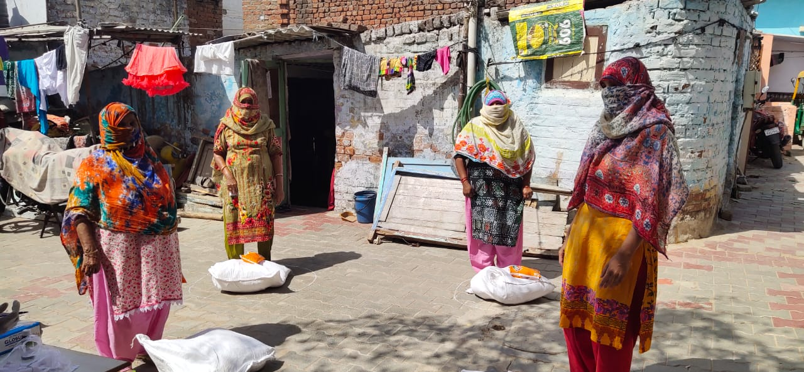
Labour reforms in times of crisis – The Wage Code (2019) in India
Catharina Hänsel
Scuola Normale Superiore and University of Göttingen

Slide 2
1. Labour Laws - Chronology
August 2019
Code on
Wages
March 23, 2020
First lockdown
begins
August, 2020
Social Security
Code
October, 2020
Nation-wide
General Strike
April, 2021
Second lockdown
begins
May 14, 2021
ILO raising “deep concern” about the labour code
June 09, 2021
SC ruling on
Migrant Workers’
Social Security

Slide 3
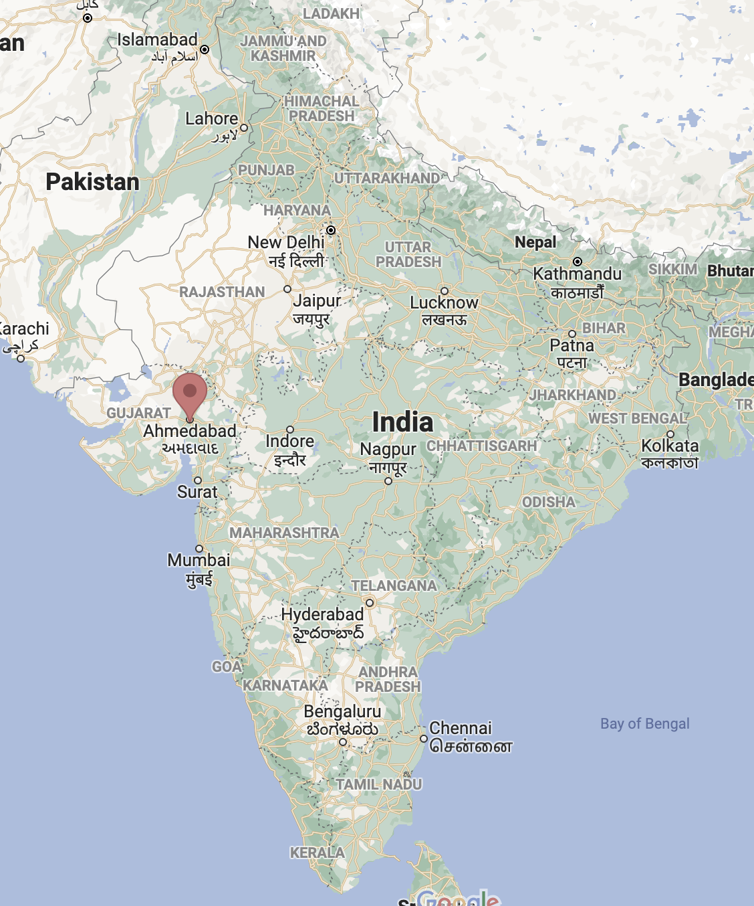
2. Shop floor - The Narol textile industry
Production for
Domestic Market 85-90%
Global Market 10-15%
Number of factory units: 5000
Average workers employed: 5-250
Average women’s income: Rs. 4,500-5,500
Average men’s income: Rs. 8,000-10,000
„flexible“ 12h shifts

Slide 4
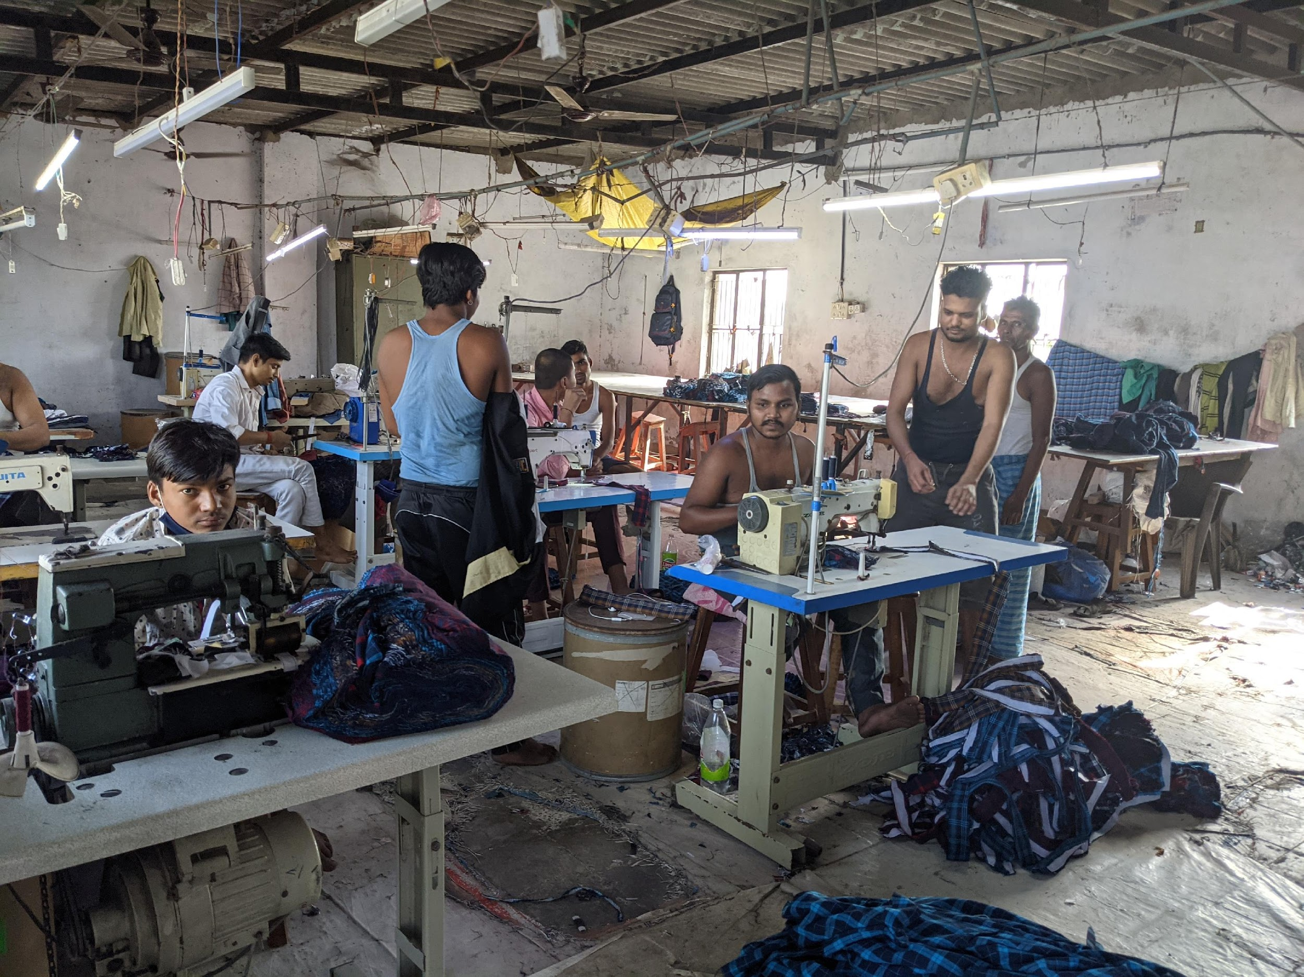
Textile Production in Narol (stitching unit), October 2021

Slide 5
3a. Household reproduction: access to government relief during the crisis
%
N=400

Slide 6
3b. Support in accessing outstanding wage payments
Out of which actually processed - 92
Total amount of wages claimed: Rs. 946576

