Slide 1
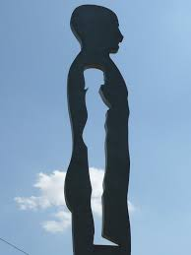
The “Danish Girls” in workplace and labour market.
Barriers and Prejudices towards gender identity
Nicola Deleonardis, PhD
Caterina Mazzanti, PhD

Slide 2
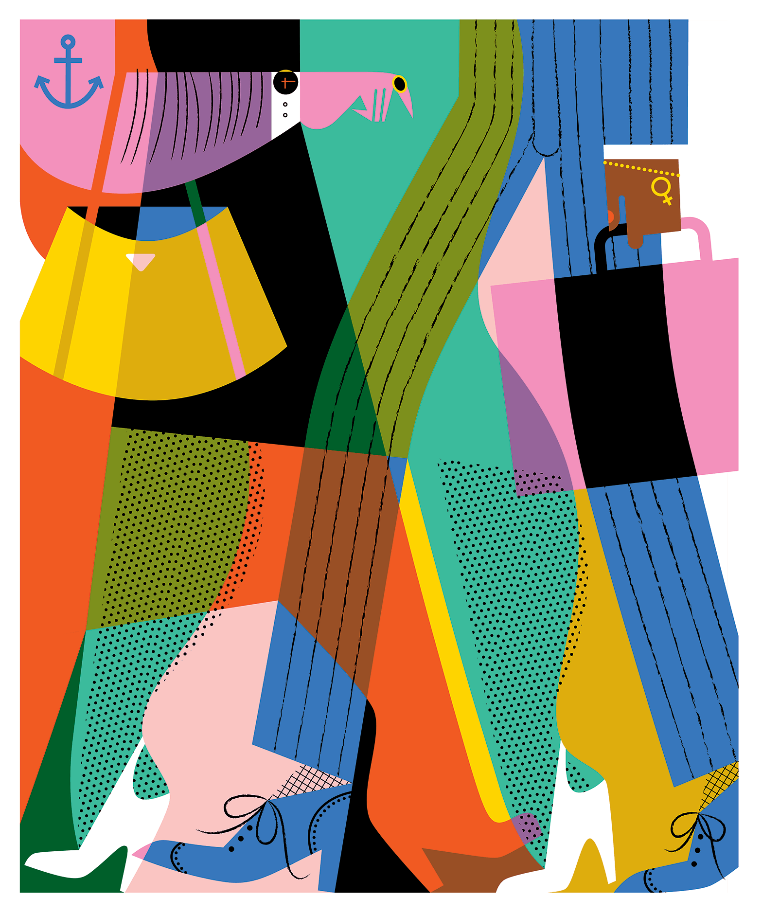
The value of work
for TRANS PEOPLE

Slide 3
For trans people work plays a crucial role
No support by families

Slide 4
Discrimination against trans people in Italy.
An historical background

Slide 5
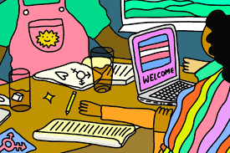
The importance of work for
the self-realization of the person

Slide 6
The need of protection
for TRANS PEOPLE
In the international Conventions

Slide 7
The need of protection
for TRANS PEOPLE
In the European Law
TRANS PEOPLE
NOTION OF GENDER

Slide 8
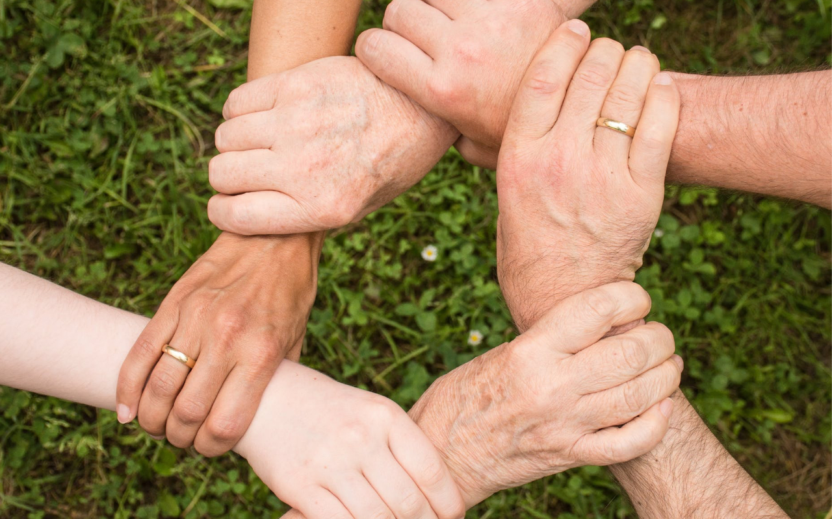
Why is important to consider trans people vulnerable?

Slide 9
Improving job placement for TRANS PEOPLE

Slide 10
The importance of promoting a culture of inclusion

