Slide 1
CODEBAR (Spain)
Nuria Ramos Martín. University of Amsterdam
(n.e.ramosmartin@uva.nl)
Ana B . Muñoz Ruiz. University Carlos III of Madrid
(anabelen.munoz@uc3m.es)

Slide 2
Research questions:
How do employers and trade unions at the level of companies (strategically) deal with decentralized bargaining?
What are the experiences of employers and workers representative regarding the quality of negotiations at that company level?
And what about the bargaining outcomes of these?

Slide 3
The 2012 labour reform: the starting point
Issues | Aim of the Reform | New regulation
Duration of collective agreements | To update collective agreements | Limit the period of duration
Collectives agreements at company level | Decentralization | Priority of collective agreement at company level over the sectoral agreement
Opt-out | To increase the internal flexibility | More flexible causes of opt-out and a simple procedure

Slide 4
Why don’t the companies negotiate a specific collective agreement?
1. Lack of knowledge of negotiating
2. The refusal of workers representatives
3. The lack of workers representatives
4. The collective agreement at sectoral level is appropiate for business needs
5. Cultural gap between American companies and Spanish trade unions (DuPont)

Slide 5
MANUFACTURING SECTOR
Sectors and subsectors:
Steel metallurgy (metal).
Chemistry.
Agrifood.
Atomization of collective bargaining.
There are different models of collective agreements structure.
A high number of provincial agreements that affect various sectors and subsectors that, however, do not guarantee that many workers do not have reference agreements

Slide 6
MANUFACTURING SECTOR
Judicial conflicts on the legitimation of the business association
Judgment of the Supreme Court of 30.12.2015 (Rec. Nº 255/2014).
The national association of plastic industries (ANAIP) brought an action before the National Audience against the chemical collective agreement alleging that the sector of plastics processing should be excluded from the collective agreement of chemical sector.
It seems that one of the factors of the judicial conflict was the weakness of the sectoral collective agreement for a short period of time.

Slide 7
RETAIL
Fragmentation.
Weakness of the bussiness association at state level. Union have tried to negotiate with the CEOE at the state level but the CEOE has refused the invitation.

Slide 8
RETAIL
Large companies have their collective agreement at state level. However, SMEs are covered by provincial collective agreement and different provincial agreement according to the different factors. It is possible to find a sectoral collective agreement which regulates the working conditions of 50 employees.
Case study - supermarkets: Lidl and Mercadona.

Slide 9
Why don’t trade unions and business association negotiate collective agreement at sectoral level?
1. Difficulties of business association to negotiate with several trade unions
2. Specialised tasks of employees may justify the existence of different collective agreements
3. Mutual responsibility (trade unions)

Slide 10
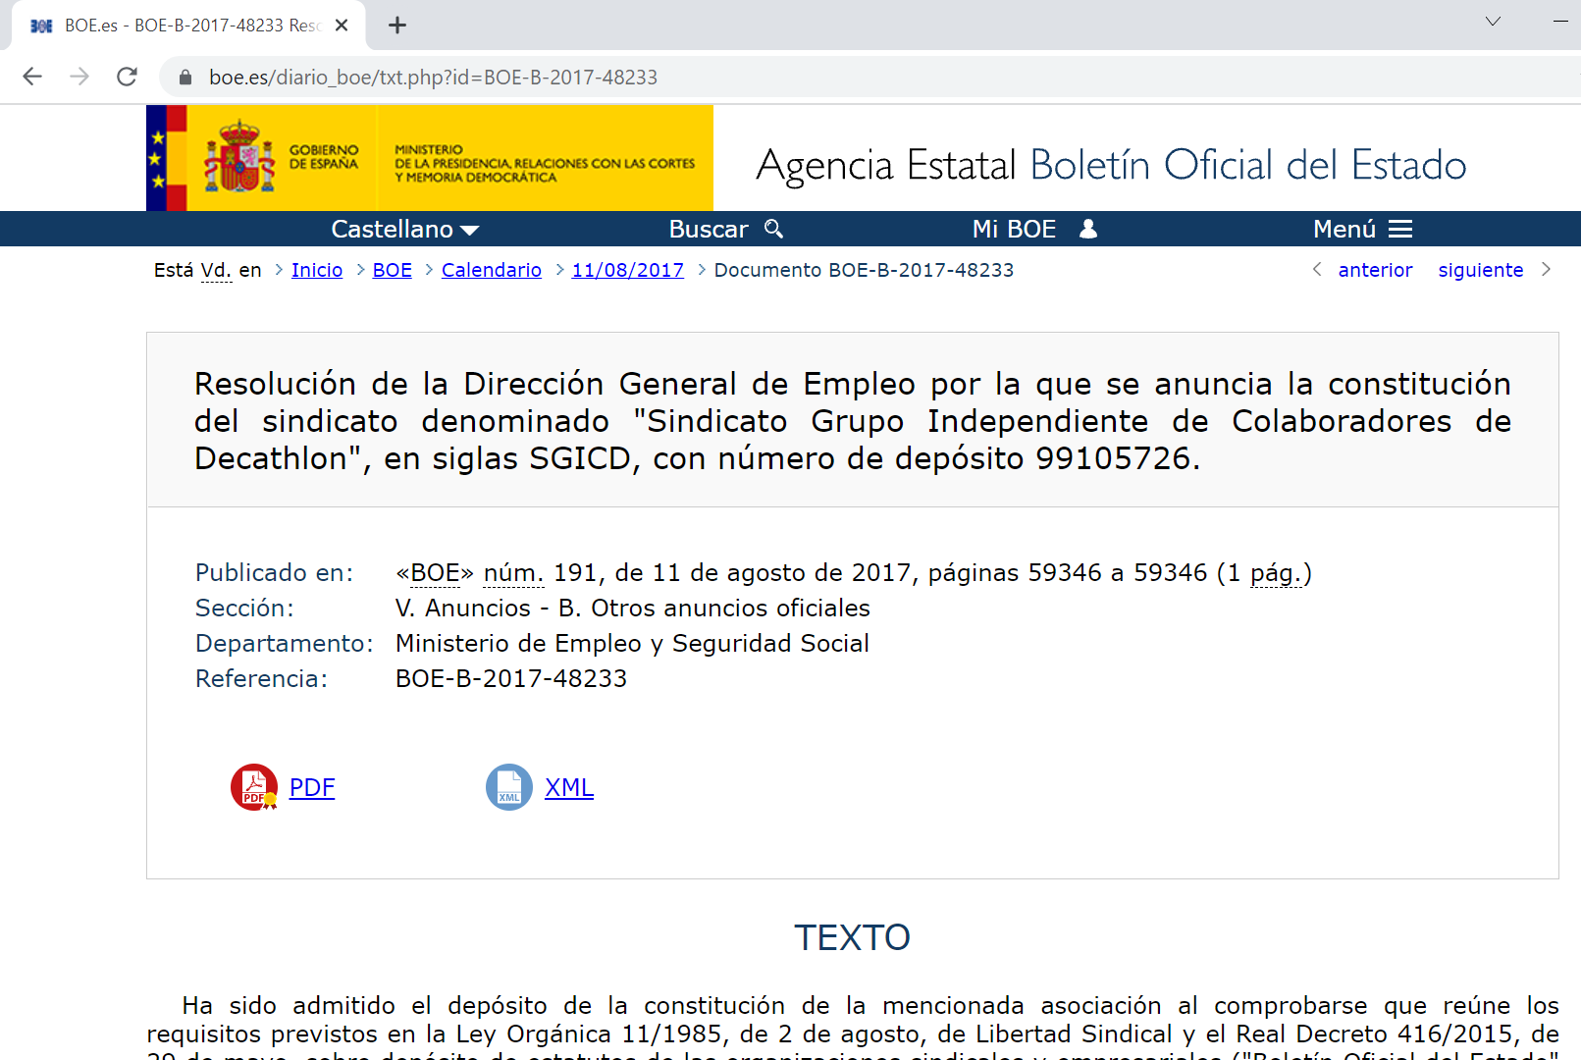
Case study-Decathlon: the creation of instrumental union

Slide 11
Decentralization: outcomes

Slide 12
Decentralization: outcomes

Slide 13
Regulatory drivers of foreseen new legal reforms
The reform shall not only focus on the priority of the collective agreements at sectoral level.
The reform shall reduce the fragmentation of bargaining units. The reform may create incentives to negotiate at sectoral level. For example, public support for training only if the parties have tried the negotiation.

