Slide 1
Valeria Filì
Full Professor of Labour Law at the University of Udine
President of Equal Opportunity Committee

Slide 4
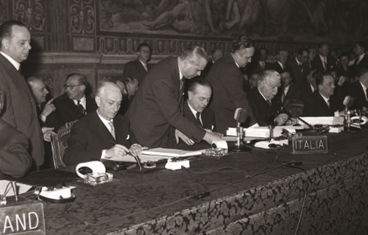
Treaty of ROME – 1957
European Economic Community (EEC)
Article 119
later
Art. 141 EU Treaty
now
Art. 157 TFEU

Slide 6
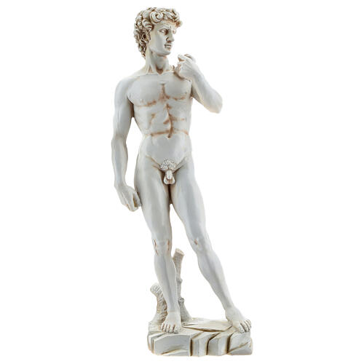

Slide 9
