Slide 1
El Big Data como instrumento potenciador de los procesos de selección de trabajadores
Big Data as a tool to enhance recruitment processes
Roberto Fernández Fernández

Slide 2
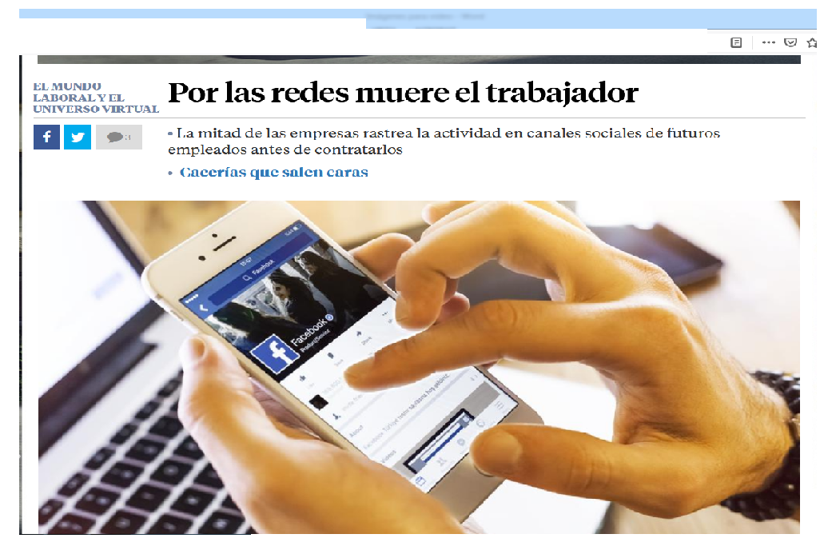
Roberto Fernández Fernández
Increasingly, companies are using in their selection processes some kind of algorithm during the procedure that allows an initial screening of the applications submitted, so that these are introduced into computer programmes that, through certain predetermined patterns, can quickly and easily select the applicants who will move on to the next stages of the selection process, in an action that can cover all the selective phases. In addition, there are already companies that specialise in trawling social networks, giving rise to what have become known as "nethunters" or network headhunters.

Slide 3
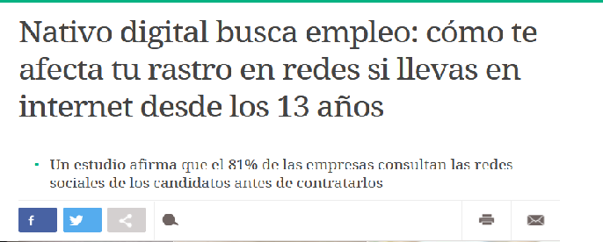
Roberto Fernández Fernández
ICTs, in general, and social networks, in particular, are configured as tools capable of allowing access to a large volume of information while at the same time making it possible to process it quickly and cheaply, which ultimately translates into the creation of profiles that provide details of how, where and when services are provided, It is not always easy to establish privacy filters on many of the platforms used and to restrict who can see their content, although the network itself often requires that certain data be accessible to the general public.

Slide 4
Roberto Fernández Fernández
The Spanish Data Protection Agency points out that half of the social network users analysed have their user profile without privacy restrictions and available to be visited by any other interested party.

Slide 5
Roberto Fernández Fernández
Big Data offers hitherto unexplored possibilities, firstly it offers a broader working platform such as the internet and/or social media which allows to build a digital footprint of the candidate and secondly a combination of these new tools with classical recruitment strategies are a source of information hitherto unknown to recruiters, who can access personal images, living conditions, social relations, skills, etc., which allows them to form a more vivid picture of the candidate and thus get a much more accurate reflection of the person.

Slide 6
Roberto Fernández Fernández
For the reasons given above, it is necessary to be aware of how a conduct carried out at a certain moment that may seem innocuous can, over time, have an adverse effect on finding future employment, as the tracking of the candidate's actions and the information that the employer may have may constitute the differential element when it comes to obtaining a job or not.

Slide 7
Roberto Fernández Fernández
Whatever the system used by the company and whatever the technology used to select its future employees, what must be clear is that it must respect the fundamental rights of workers in the selection processes put in place.

Slide 8
Roberto Fernández Fernández
Artificial intelligence is a tool that must be used ethically by companies, with heteronomous or autonomous norms in each country setting the limits of such moral behaviour, as it is essential to return to social control of technological changes in which respect for certain minimum rights and protections is demanded.

Slide 9
Roberto Fernández Fernández
Several solutions to try to ensure respect for the fundamental rights of workers:
1.- Allowing the participation of workers' representatives in the generation of these algorithms, and auditing their results with controls and tests on a continuous and dynamic basis in order to avoid any infringement of the principle of equality and the application of discriminatory biases by these technological tools, as has partially done at least ensuring the right to be informed, Article 64. 4 of Royal Legislative Decree 2/2015, of 23 October, approving the Consolidated Text of the Workers' Statute, in the wording given by the sole article. one of Law 12/2021, to guarantee the labour rights of persons engaged in delivery in the field of digital platforms.

Slide 10
Roberto Fernández Fernández
2.- Use the blind curriculum vitae throughout the selection process, in such a way that the identification of the candidate's personal circumstances that are not transcendental for the recruitment cannot become a decisive factor in the hiring process.

Slide 11
Roberto Fernández Fernández
3.- Limit the access of recruitment companies, recruitment agencies and people responsible for human resources in companies to general social networks, so that they can only access professional social networks (such as LinkedIn, Infojobs, Monster or Xing, as is the case, for example, in Germany).

Slide 12
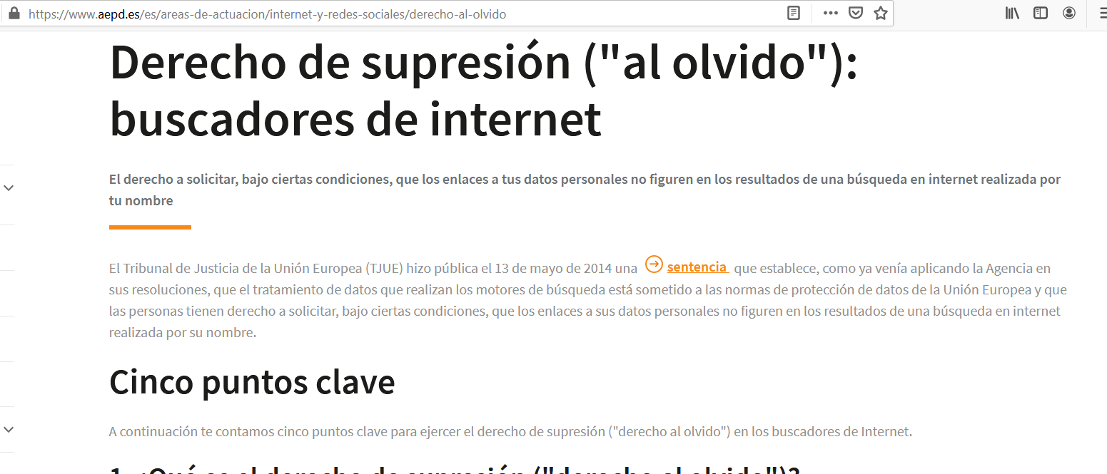
Roberto Fernández Fernández
4.- To promote the so-called "right to be forgotten" or the right of deletion regulated in Article 17 of the General European Data Protection Regulation, which allows the removal of links from a list of results to be requested when the information itself is inadequate, inaccurate, irrelevant, outdated or excessive or has been characterised as such by the passage of time.

Slide 13
Roberto Fernández Fernández
Thank you very much for your attention

