Slide 1
The minimum wage as an instrument to provide the dignity at work
Dr Katarzyna Bomba
University of Warmia and Mazury in Olsztyn, Poland
The contribution is the effect of the reserach project No. 2017/26/D/HS5/01050, financed by the National Science Centre, Poland

Slide 2
The main issues:
The international and the European legal instruments that refer to the minimum wage.
The minimum wage from the perspective of human rights.
Current international and European initiatives on the minimum wage.
Conclusions on the suitability of minimum wage for ensuring the dignity at work.

Slide 3
The legal instruments that refer indirectly to the minimum wage:
UN Universal Declaration of Human Rights (art. 23 ust. 3)
UN International Covenant on Economic, Social and Cultural Rights (art. 7 lit. a (ii))
ILO Constitution (preambule)
ILO Declaration of Philadelphia (part III lit. d)
European Social Charter (art. 4 sec. 1)

Slide 4
The legal instruments that refer directly to the minimum wage:
ILO Minimum Wage-Fixing Machinery Convention, 1928 (No. 26),
ILO Minimum Wage Fixing Machinery (Agriculture) Convention, 1951 (No. 99),
ILO Minimum Wage Fixing Convention, 1970 (No. 131).
European Pillar of Social Rights (sec. 6 lit. b)),
Proposal for a Directive of the European Parliament and the Council on adequate minimum wages in the European Union.

Slide 5
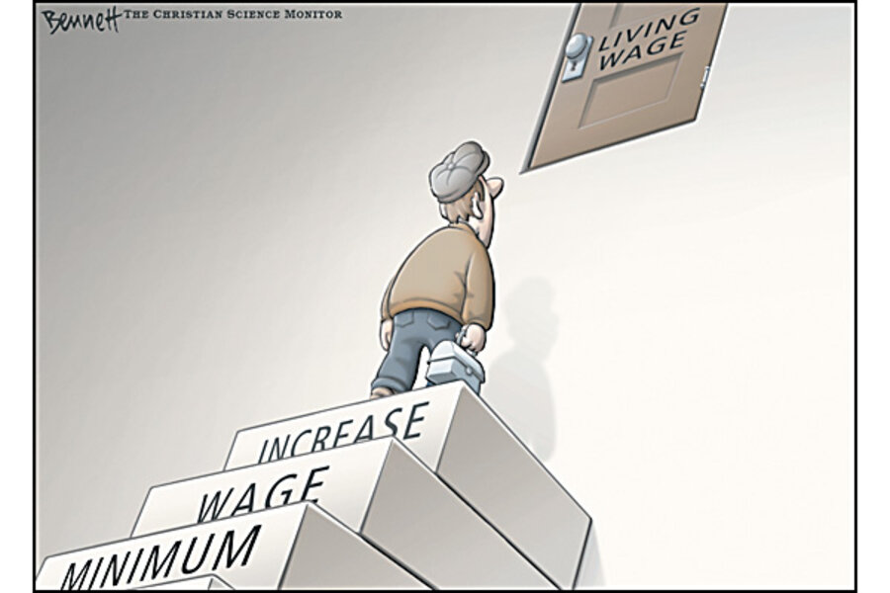
Source: https://www.csmonitor.com/Business/The-Circle-Bastiat/2010/0831/

Slide 6
The criteria for fixing the minimum wage:
The social criteria: | The economic criteria:
Needs of workers and their families, with regard i.a. to: the general level of wages in the country, the cost of living, the social security benefits, the relative living standards of other social groups. | Requirements of economic development, Levels of productivity, The desirability of attaining and maintaining a high level of employment, etc.
Both economic and social factors should be taken into account in order to fix the minimum wage in a specific country.

Slide 7
The minimum wage definition:
The minimum wage is the minimum sum payable to a worker for work performed or services rendered, within a given period, whether calculated on the basis of time or output, which may not be reduced either by individual or collective agreement, which is guaranteed by law and which may be fixed in such a way as to cover the minimum needs of the worker and his or her family, in the light of national economic and social conditions.
(the ILO Committee of Experts)
The minimum wage is not always the economic equivalent of the work performed.
The employer is obliged to provide the minimum wage even if the value of economic output is lower.

Slide 8
Minimum wage and human rights:
Society based on justice and solidarity should guarantee each individual adequate living conditions to exercise his/her human rights.
With regard to workers the State transfers this public task to the employers.
The minimum wage should provide the material basis of existence and it should make it possible for the individual to enjoy human rights.
It should guarantee the income that safeguards adequate living conditions for workers and their families.
Where necessary, the minimum wage should be supplemented, by other measures of social protection, especially social security benefits.

Slide 9
Source: https://www.elllo.org/english/0951/

Slide 10
Minimum wage in the selected current international and European initiatives:
2008 ILO Declaration of Justice for Fair Globalization
2015 ILO Resolution concerning the recurrent discussion on social protection (labour protection)
2019 ILO Declaration of the Century for the Future of Work:.
The minimum wage as the element of the decent work and sustainable development paradigm.
The minimum wage as one of indicators to evaluate progress in providing decent work at the national level.
The United Nations 2030 Agenda for Sustainable Development (Goal 8th)
The European Pillar of Social Rights of the European Union:
The draft directive on adequate minimum wages in the EU:
The Declaration adopted 7.5.2021 in Porto Social Summit of the European Union

Slide 11
Conclusions:
The minimum wage as such is not always sufficient to provide dignity at work and decent standard of living for workers and their families.
The minimum wage should be fixed with reference to the national economic and social circumstances.
The employer’s duty to pay at least the minimum wage (regardless the economic output of work performed) fulfills public tasks in order to safeguard decent standard of living for each worker and his/her family.
The national minimum wage that has been fixed below the decency threshold should be supplemented by social security benefits.

Slide 12
Conclusions:
On the global level, the minimum wage is an important tool to achieve the paradigm of social, economic and environmental sustainable development.
The minimum wage reflects social factor of sustainable development. However, it also influences its economic and environmental dimensions.
The minimum wage is a tool to prevent the dehumanization of work.
Adequate minimum wage policy allows to improve the position of precarious workers.

Slide 13
Thank you for your attention.
katarzyna.bomba@uwm.edu.pl

