Slide 1
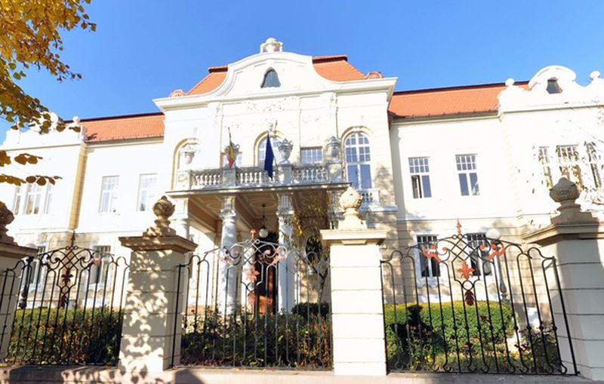
The challenges of returning to work after chronic illness in Romania - a conceptual and analytical framework and preliminary results
Adela Popa, Felicia Morândău, Anca Bejenaru, Livia Pogan, Cristina Mitrea
Lucian Blaga University of Sibiu, Romania

Slide 2
General context
Labour market participation in EU countries including Romania
Increasing chronic morbidity
Increasing mean age of the population
The labour force reduction
Negative impact on the social protection system
Critical to ensure an inclusive labour market (Scaratti et al. 2018)
A considerable proportion of the working age population with CDs returns to work (RTW)
Working age population with chronic diseases (CD) in 2019
EU-27: 29%
Italy: 8.3%
Spain: 20.4%
Romania: 9.3%
Notes:
https://ec.europa.eu/eurostat/databrowser/view/HLTH_SILC_04__custom_1596997/default/table?lang=en

Slide 3
Labour market context and RTW
 | EU-27 | RO | IT | ES
Employment rate - 2019 (20-64 years, %) | 73 | 71 | 63 | 68
Unemployment rate -2019 (20-64 years, %) | 6.6 | 3.7 | 10 | 14
Activity rate – 2019 (20-64 years, %) | 78 | 74 | 71 | 79
Romanian labour market situation is not worse than other countries, yet…
Other EU countries - important steps towards facilitating RTW (national legislation, dedicated policies at company level, collaboration of stakeholders)
Romania (and other CEE countries) has just begun to approach and study RTW (Popa et al. 2020)
Return to work is a complex process, with many factors and stakeholders (Belin et al. 2016)
Has significant benefits for the worker and the society (Roelen et al. 2011b)

Slide 4
Chronic diseases and invalidity context
Four categories of diseases have the greatest impact on the working population in Europe:
cardiovascular diseases (CVD)
cancers
musculoskeletal diseases (MSD)
mental conditions
MSD cause almost 50% of all absences from work in the EU and 60% of the permanent work incapacity
(Bevan 2013)
Cancer and mental disorders produce frequent and/or long-term sick leave spells
(OSHWiki 2018)
For many workers going back to work is possible (with proper support) and they wish to return from long-term sick leave or from invalidity pension
In Romania 82% of the invalidity pensioners have a reviewable disability (may be rehabilitated and may return on the labour market)
Notes:
Reviewable invalidity consists in various types and degrees of invalidity which might be solved, thus resulting in regaining the work capacity

Slide 5
The project
The challenges of returning to work after chronic illness in Romania: barriers, facilitators and collaboration of stakeholders
3 years project, with national funding (Exploratory Research projects), starting from January 2021
Study design: mixed-methods, exploratory study
Six diseases:
Cardiovascular
Cancer
Chronic respiratory
Diabetes
Musculo-skeletal
Mental disorders
Concepts:
Return to work
”Procedures and initiatives aimed at facilitating the workplace reintegration of persons who experience a reduction in work capacity or capability, whether this is due to invalidity, illness or ageing” (ISSA, 2013)
Chronic diseases
Stakeholders

Slide 6
Research questions:
Desk analysis on policies
What is the context of RTW with a CD in Romania? (literature and legislation on sick leave, invalidity and working with CDs)
What are the motivations, barriers and facilitators for RTW of workers with CDs or job seekers with CDs?
What are the motivations, barriers and facilitators of employers who receive back at work workers with CDs?
What are the views of health professionals on RTW after CDs?
What are the views of NGOs regarding social and labour market reintegration of people with CDs?
How do all stakeholders experience the existing collaboration between them and how this collaboration could be improved?
What can be done to raise awareness at all levels on the benefits and expected outcomes of RTW after CD?
Online survey for workers
Interviews with:
Employers
Health professionals
Civil society actors
Online survey and interviews
Interviews

Slide 7
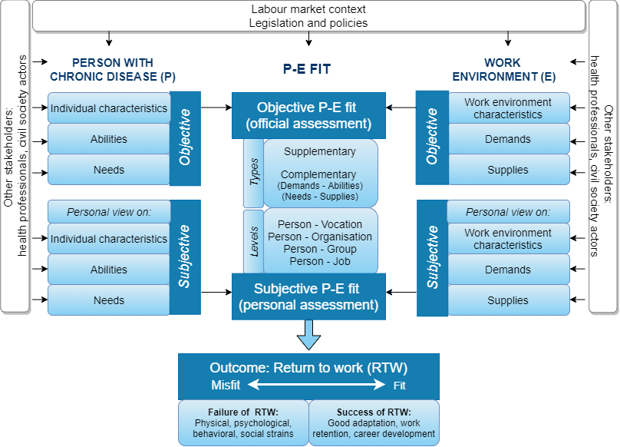
Conceptual and analytical framework proposed:
Informed by the theory of Person-Environment Fit (Caplan 1983; 1987; Verquer 2003; Cox, McLennan, N’Dow 2014)
Notes:
We studied before RTW and we were in need of a comprehensive theory to explain the complexity of RTW. So we build this conceptual framework based on the Theory of P-E Fit, which is not so new but it has great potential (it was developed by many authors in relation with various concepts).
The theory posits that the intersection between the person (employee) and the work environment is critical in understanding adjustments in organizations. And RTW can be understood as an adjustment. So the theory maps the characteristics of both the person and the environment and analyses the results of the combination of these characteristics. The person has needs and abilities and the organization has demands and provides supplies. From the combination of these results the person-environment fit, represents the degree of compatibility between the characteristics of the employee (person) and of the work environment. The P-E fit is the central concept of this theory.

Slide 8
The objective fit is officially assessed by employers, health professionals and recruiters
The subjective fit represents the employees’ self-perceptions and assessments of their fit with the work environment
Types:
The supplementary fit = how much similarity is between the goals, values and norms of the worker’s and the organisation
The complementary fit = in what extent do they complement each other
The demands –abilities fit = are the organisational demands fulfilled by the abilities/ knowledge of the worker with a CD?
The needs-supplies fit = are the workers’ needs satisfied by the supplies (resources such as adjustments in workload, schedule, support) offered by the organisation
Levels:
All the four levels may be understood either objectively or subjectively
Notes:
Thus, a worker living with a chronic illness may feel a strong attachment to a vocation path, although he/she might change jobs within the vocational field (misfit between person-job but fit between person-vocation). Or, as another example, a worker keeps in touch with colleagues (group) the entire period of sickness absence, yet he/she feels disconnected from other parts of the organisation (person-group fit and person-organisation misfit).

Slide 9
Many outcomes of the P-E fit have been studied so far: job crafting (Tims 2016), interest congruence and performance (Nye 2017), work attitudes (Veerquer 2003), adjustments of the new workers (Saks 2007)
We propose a new outcome of the P-E fit: the return to work of workers with CD
The P-E fit can be understood as a continuum, from misfit (incongruence between the person with a CD and the work environment) to fit (congruence)
Misfit can manifest as physical, psychological, or social strains of the worker with a CD who returns in the workplace
This means: a difficult or failed process of RTW
The P-E fit takes the form of a good adaptation after RTW, career continuation and development, sustainable RTW and work retention on the long term
This means: a successful RTW process
In case of P-E misfit, interventions can be applied to the person (i.e. finding new ways of coping, vocational rehabilitation, counselling) or to the work environment (increasing work accommodations, interventions targeted to the employer). Thus the P-E fit may increase.

Slide 10
Results so far: 1. Desk analysis on policies
Report on Romanian policies relevant for working with CDs
Romanian legislation provides only general provisions on the recovery of work capacity. They are indirectly related to RTW
No specific provision for RTW facilitation after the sick leave
The RTW cannot be phased as in other countries, but employers can allow workers to resume work on a part-time (4 hours) schedule first
RTW roles: the specialist and occupational physician, the employer, the social security expert physician and the local public employment agency
The employer has a marginal role in RTW!
Other actors such as NGOs or support professionals (psychologists, social workers) have no formal role in RTW
The provisions on the recovery of work capacity may be considered active labour market policies (but they regard only the medical rehabilitation)

Slide 11
Results so far: 2. Survey and interviews
Work in progress
Survey for workers was just launched:
https://www.surveymonkey.com/r/munca1
Interviews with employers, physicians and civil society actors - in 2022
From previous research (on RTW after cancer) we know that:
The formal support offered to the employees with cancer for RTW is scarce
Health professionals don’t mention or even discourage RTW
RTW is not planned or phased, and rarely accommodations are offered
Discrimination reported in more than half of the cases for those who return
Patients
Employers complain of the lack of legal and organizational flexibility,
They wish to have clear procedures and guidelines for RTW
They wish to have more collaboration with other actors involved
Employers
NGOs have a very narrow involvement in cancer survivorship
Only 5.2% aim to offer support for work reintegration of cancer patients
NGOs

Slide 12
Future outcomes of the project
Besides academic results:
A policy brief
Support materials (flyers) for workers and employers
The Return to Work Portal (to be done in 2023)
A website in Romanian, based on project results, gathering all resources in one place
Specific content for every category of stakeholders (workers, employers, health professionals, colleagues, family etc.)
Information on legislation
How-to type of information for specific situations (e.g. how to communicate with an employee with a chronic illness)
Resources (links to other websites, available sources of support etc.)

Slide 13
Thank you!
Contact: adela.popa@ulbsibiu.ro
Website of the project:
https://sites.google.com/a/ulbsibiu.ro/adela-popa/cercetare/chronic-conditions-and-work-project
Acknowledgment:
Paper done within the project The challenges of returning to work after chronic illness in Romania: barriers, facilitators and collaboration of stakeholders (RTW-CI), project code PN-III-P4-ID-PCE-2020-1384, delivered by Lucian Blaga University of Sibiu, with funding from CNCS-UEFISCDI

