Slide 1
WORK AND ITS VALUE
Interdisciplinary Reflections on an Ever-Changing Concept
International Conference, 26th November 2021
THE CONVENTIONS
FAVOURING ACCESS TO EMPLOYMENT OF PERSONS WITH DISABILITY:
A GENUINE TOOL TO PROMOTE THEIR VALUE
Massimiliano De Falco
Notes:
Good afternoon to everyone.
First of all, I would like to thank Professor Zilli for the presentation, as well as the ADAPT Association and the INTERNATIONAL LABOR ORGANIZATION for giving me the opportunity to speak at this presticious international conference.
Given that work is an instrument for the fulfilment of the person, beyond economic exchange (especially in the context of the transformation underway), my reflection aims to focus on the value of the work done by persons with disability. Indeed, very often, they are considered "second-class workers", rather than resources.
In this regard, I will try to measure it through the conventions favoring access to employment, which, in my opinion, constitute an effective and genuine tool for a real appreciation of their work, that is actually undervalued.

Slide 2
Work and its Value
«The expression “work” identifies every human activity susceptible of economic evaluation» (M. Biagi, Istituzioni di diritto del lavoro, 2001).
Every person can carry out a work activity, which creates value for the company:
making profit ≠ creating (and disseminating) value
Notes:
Since this is an international conference on the value of work, I am going to start from the consideration of Professor Marco Biagi, for which: “The expression “work” identifies (or consists in) every human activity susceptible of economic evaluation”.
From this definition, we can deduce that every person (regardless of his – or her – health condition) can carry out a work activity, which creates value for the enterprise.
Nonetheless, it is usual that the economic evaluation made by the entrepreneur leads to the confinement of persons with (allegedly) reduced performance. Hence, very often workers with certain personal characteristics oversee secondary importance tasks in comparison with the core business of the company.
However, it should be mentioned that many economic studies have long since highlighted the differences between “making profit” and “creating (and disseminating) value”, by exalting (in this second hypothesis) the role of corporate social responsibility, the circular economy and sustainability.
In these terms, the “benefits enterprises” represent an evolutive concept: these companies integrate (into their “social object”, in addition to profit objectives) the aim of having a positive impact on society and the biosphere.
These “benefits enterprises” place the dignity of workers at the centre, beyond the traditional references to wages, which has been (for a long time) the measuring parameter of “work’s value” from the point of view of labor law.

Slide 3
Agenda 2030 and EGS indexes
Sustainable and Equal Development
State of the Art
Enviromental: all companies are following a “green way”, also thanks to funding, incentives and facilities.
Governance: models provided by D. Lgs. N. 231/2001 have already regulated best practices
Social: there is still a long way to go for the labour inclusion of disadvantaged persons, who are still seen as a cost and not a resource.
Notes:
The main criteria for measuring sustainability are those developed to define the action programme “for people, planet and prosperity” signed (in “two thousand fifteen”) by “one hundred ninety-three” United Nation countries, corresponding the “two thousand and thirty” Agenda for Sustainable and Equal Development.
In addition, in a perspective of coherence and systematicity, there are also EGS economic and financial indexes. They are used to indicate all those activities linked to responsible investment, which pursue objectives typical of financial management objectives, considering environmental, social and governance aspects.
As regards the environmental profile, all companies are following a “green way” today, boosted by funding, incentives and facilities.
Similarly, organizational, management and control models (introduced by Legislative Decree “two hundred thirty-one” of “two thousand one”) have already regulated best practices in terms of corporate governance.
In the meantime, the social profile has not been addressed yet by companies and legislation. This is particularly true in relation to the employment inclusion of disadvantaged persons, who are still seen as a cost and not as a resource.
Therefore, the question to be asked is whether there is a model able to maximize the employment of persons with disability in the labor market, creating (at the same time) added value to the industrial production chain and (also) creating a real advantage for all stakeholders.

Slide 4
Legislative Requirements
Art. 3, L. n. 68/1999: obligation to recruit persons with disability:
1 worker, for companies with 15-35 employees;
2 workers, for companies with 36-50 employees;
7% of employees, for companies with more than 50 employees
Notes:
In our legislative system, Law “sixty-eight” of “nineteen nineteen” establishes the obligation to employ a certain number (which I have indicated to you on this slide) of disadvantaged persons, depending on the employment size of the company.
The same law identifies (as a large part of disadvantaged persons) “persons with disability”, who have a certain percentage of reduction in their working capacity.

Slide 5
Sanction for the Employer
Art. 15, L. n. 68/1999: if the employer does not comply the recruitment obligation, administrative sanctions are applied for each working day of failure to employ person with disability, setting an amount equal to five times the contribution exemption provided for in art. 5, c. 3-bis.
39,21€ $×$ 5 $×$ 260 annual working days =
50.973 € per year
Notes:
If the employer does not comply the recruitment obligation, the same law (recently amended by a decree of the Minister of Labor and Social Policy) provides for administrative sanctions for each working day of failure to employ person with disability, setting an amount equal to five times the contribution exemption provided for in article five.
Given that the current exemption contribution is approximately “forty” euro, the sanction for each day of non-employment is “two hundred” euro. So, if we multiply this amount for “two hundred-sixty” working days, a company compelled to employ (even only) a person with disability risks a sanction of more than “fifty thousand” euro per year.

Slide 6
Opportunities for the Company
1.
The company can employ the person with disability directly, but it faces some disadvantages: i) difficulty of integrating the person with disability into the organization, ii) increased costs linked to tutoring requirements, iii) lower productivity, iv) increased absenteeism
The company can bear the sanctions for failure to employ persons with disability, rather than employing them according to the mandatory quotas.
2.
Notes:
There are three different ways for companies that are mandatory to employ persons with disability.
In the first case, the company can employ the person with disability directly, but it faces some disadvantages: in addition to the general difficulty of integrating the person with disability into the organization, the company would have increased costs linked to tutoring requirements, lower productivity and increased absenteeism (especially under the provisions of law number “one hundred four” of the “nineteen ninety-two”).
In the second case (unfortunately, a choice often preferred by companies of large size and large capital), the employer may bear the sanctions for failure to employ persons with disability, rather than employing them according to the mandatory quotas. In this way, the policies of inclusion in the productive system, promoted by the legislator in favor of disadvantaged people, would be nullified.

Slide 7
Opportunities for the Company
3.
The company can derogate from direct recruitment, without paying sanctions.
Art. 14, D. Lgs. n. 276/2003
The person with disability is employed by the social cooperative,
to which the enterprise gives work orders, with significant advantages:
i) saving the higher costs of direct employment or sanctions
ii) benefit from supplies or services.
Notes:
In the third case, there is the possibility of derogating from direct recruitment, without paying penalties.
This opportunity was introduced by Article fourteen of Legislative Decree number “two hundred seventy-six” of “two thousand three” (knows as “Riforma Biagi”), even if similar cases had already been provided for in Articles twelve and twelve-bis of Law “sixty-eight” of “ninety-nine ninety-nine”
In particular, the Article fourteen provides that the person with disability is employed by the social cooperative, to which the enterprise gives work orders. In this way, the obligation of the company itself to employ the person with disability is fulfilled.
So (by giving work orders to the social cooperative) it saves the higher costs of direct employment or sanctions and (at the same – or even lower – cost) can benefit from supplies or services that it currently produces itself or buys from external providers.

Slide 8
Reasonable Accommodation
Dir. 2000/78/CE, Convention UN on the Rights of Persons with Disabilities (2006): necessary and appropriate modification and adjustments, not imposing a disproportionate or undue burden, where needed in a particular case, to ensure to persons with disabilities the enjoyment or exercise on an equal basis with others of all human rights and fundamental freedoms.
Notes:
In these terms, working within a social cooperative can be understood as a “reasonable accommodation”, id est an organizational adjustment (which doesn’t entail an excessive and disproportionate cost, but, rather, involves a gain), that guarantees the right to work of persons with disability on an equal basis with others.

Slide 9
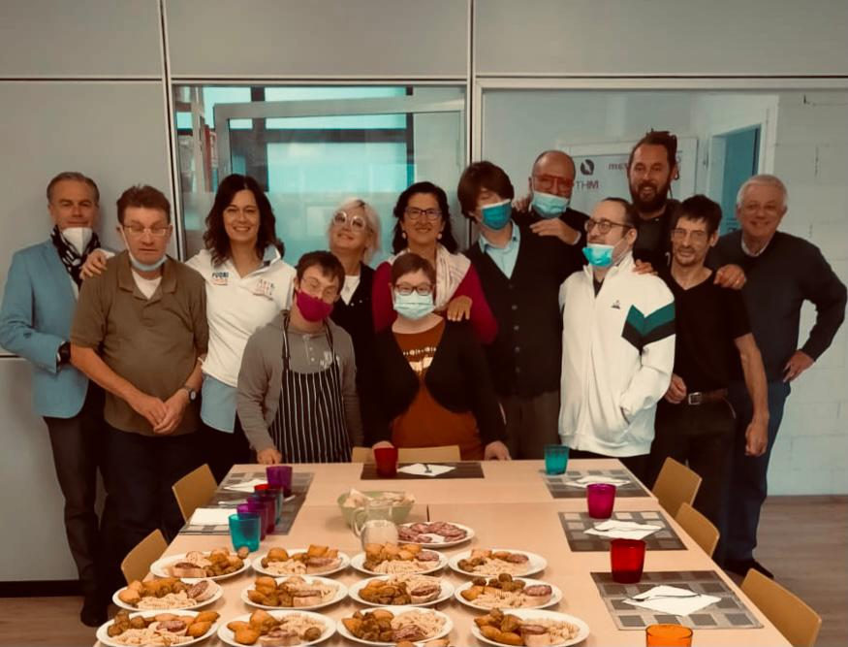
Creating Value for all Stakeholders
1. Public Administration
2. Transferring Company
3. Social Cooperative
4. Person with disability
Arte e Libro, Social Cooperative ONLUS, Udine
Notes:
Therefore, the model to be promoted (and the model that the University of Udine, in collaboration with a social cooperative and with local institutions, intends to implement) is to create a system that includes persons with disability (and social cooperatives) in the industrial production chain, with equal dignity, creating value and profit for all stakeholders, which are:
First of all, the public administration, which stipulates and validates the territorial conventions for the integration of persons with disability.
Secondly, the transferring company, which directly contracts social cooperation, in order to reach the percentage of coverage of its mandatory share.
Thirdly, social cooperatives “type B”, which represent a safe and healthy environment where the value of the work of persons with disabilities can be really recognized.
Lastly (and above all), the person with a disability, whose work, in this way, can be (finally) valued, as a worker and not as a disabled person.

Slide 10
Win-win Model
Public Administration: i) reducing care and control costs, ii) creation of a sustainable and socially inclusive model, iii) increased quality of life for the community
Transferring Company: i) no sanction, ii) economic savings, iii) bank rating, iv) social responsibility report, v) image enhancement
Social Cooperative: i) abandoning a purely welfarist perspective, ii) inclusion in the value chain, iii) economic prosperity, iv) social reinvestment, v) social objective
Person with disability: i) greater economic independence, ii) personal fulfilment and satisfaction, iii) inclusion in society as an active member of the production cycle
Notes:
This model responds to a win-win logic because it supports the role of social cooperatives in the territory and stimulates partnership processes (in the labor market) of profit and non-profit companies, aimed at outsourcing processes, that also have a social value. In particular:
The public administration (in addition to reduced costs for care and control) benefits from the creation of a sustainable and socially inclusive model, resulting in a higher quality of life for the community.
The company obliged to employ persons with disability avoids paying the sanction, achieving (as I have already said) economic savings, a better bank rating and an improvement of its image;
The social cooperative (abandoning the purely welfarist perspective) is included in the value chain, generating economic prosperity and social reinvestment, always pursuing its social objective.
But, the most important benefits concern persons with disability, who (through work) gain greater economic independence and achieve personal fulfilment and satisfaction, by being included in society as active members of the production cycle.

Slide 11
Thank You
for Your attention
Stefano Slataper, Lawyer (1964 – 2021)
Notes:
In appreciating your attention, I would like to dedicate this last slide to the lawyer Stefano Slataper (who passed away in September this year) and who devoted a large part of his scientific production to the social and labor integration of persons with disability.
The ambition to promote a shared value and inclusive model must be achieved for him as well.
Thank You again.

