Slide 1
The cyborgization of the working man. Will the dignity of human labour survive? In homage to Stanisław Lem on his centenary
ADAPT
Bergamo
24-26 November 2021
Sławomir Adamczyk, NSZZ Solidarność Barbara Surdykowska, NSZZ Solidarność

Slide 2
Introductory remarks Human being at the crossroads: between genetic and technological augmentement

Slide 3
When do you become a cyborg and what for? From necessity to entertainment and higher art Smartphone as a part of human anatomy?

Slide 4
Dilemmas of the cyborgized working man: The ILO Philadelphia Declaration and the ownership of what you have in your brain

Slide 5
A Devastating Future? Forced Cyborgization as the Answer to the Mantra of Continuously Increasing Labour Efficiency

Slide 6
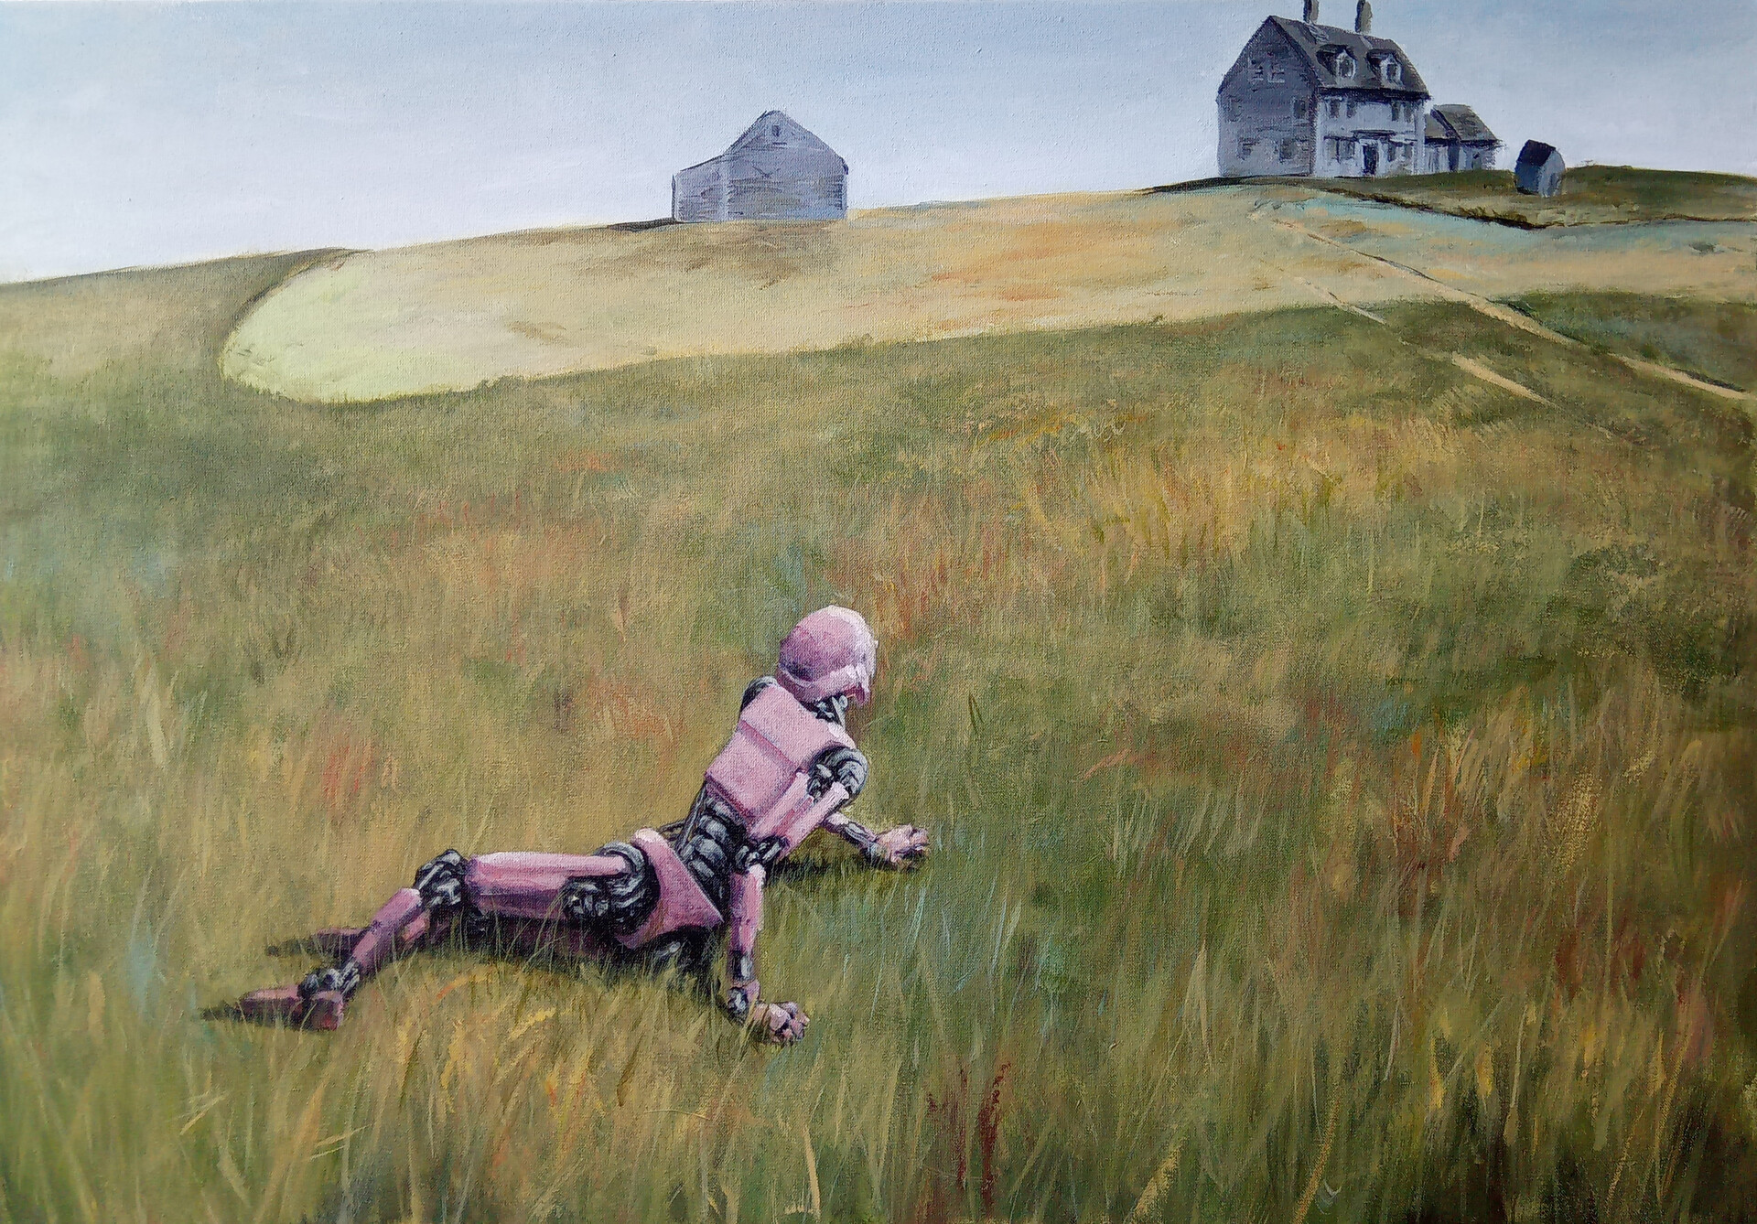
„Until democracy ends and victors show the path to follow” thank you for your attention Guillermo JBueno, Cyborg´s world

