Slide 1
Innovation and digitalisation: company practices and social dialogue
Stavroula Demetriades
Senior Research Manager
ADAPT Conference ‘work and its value’ 24-26 November 2021
Workshop: Industrial relations and social dialogue for an economy and society 4.0

Slide 2
The Eurofound-Cedefop European Company Survey 2019
Survey of (HR) managers and employee representatives (ER) in European establishments
Most senior person in charge of HR in the establishment (MM)
Official employee representative (works council/trade union)
Topics explored: Skill strategies, motivation and trust, work organisation, HRM, employee involvement, digitalisation, product market strategies, degree of competition, outcomes (productivity, financial conditions), social dialogue.

Slide 3
Digitalisation in EU establishments: (ECS 2019)
Highly digitalised | High computer use, limited use of other digital technology | High use of robots and other digital technology, limited computer use | Limited digitalisation | EU27
28% | 26% | 19% | 27% | 100%

Slide 4
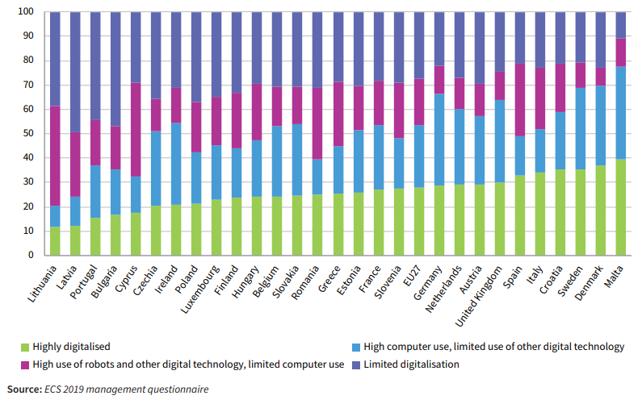
Digitalisation by country

Slide 5
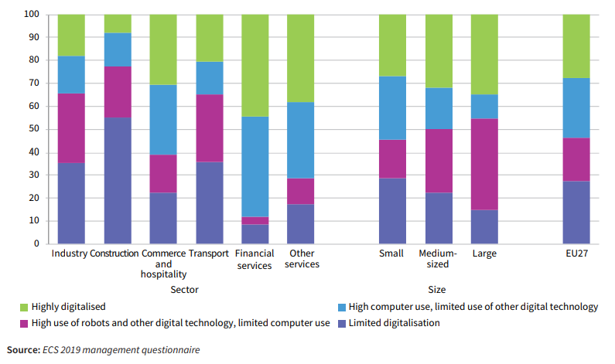
Digitalisation by sector and establishment size

Slide 6
Digital and green transition require innovation ..
New products, processes but ….with a set of management practices that use employees’ creative capital, initiative, problem solving skills, promote skill development and enhance performance

Slide 7
What kind of management practices do innovative companies adopt, how do they implement them and what motivates them?
Interviews with 22,000 HR managers in 27 EU Member States and the United Kingdom –European Company Survey 2019
In-depth interviews with 18 managers and employees in selected innovative companies (motivations, the ‘how’, enablers, barriers)
Focusing on innovation to the market

Slide 8
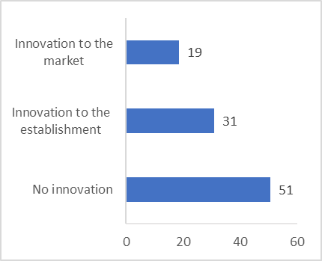
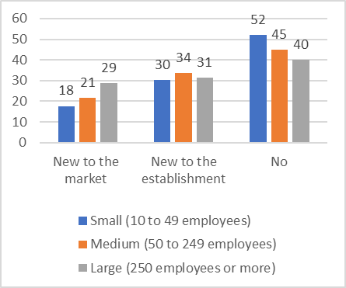
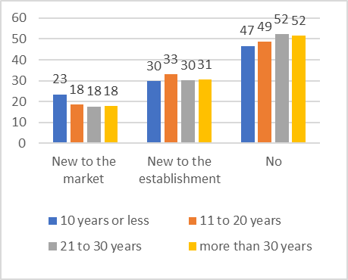
The profile of the innovative companies : Large and young companies (innovation to the market)
and ....digitalised

Slide 9
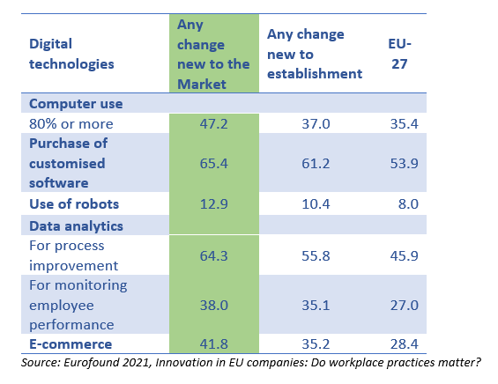
How digitalised are companies that bring innovations to the market?

Slide 10
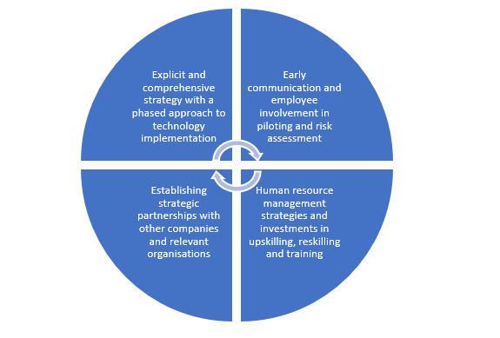
Key elements for successful technology implementation
Source: Eurofound, Digitisation in the workplace, Delphi survey

Slide 11
What practices? Results of analysis
Work organisation
High job complexity and autonomy: jobs designed to be challenging, autonomous decision making
Collaboration with other companies
HRM
High expectations on employees (help each other, stay longer if needed, making suggestions)
Motivations (monetary, variable pay, training, interesting jobs)
Employee participation
Regular meetings with line manager, staff meetings, dissemination of info, suggestion schemes, opinion on EP.
High employee influence in management decisions

Slide 12
How do you organise work?
Work organisation
High job complexity and autonomy: jobs designed to be challenging, autonomous decision making
Collaboration with other companies
Innovation is part of the job
Job descriptions evolve
Management open attitude towards failure; dedicated group meetings for harvesting ideas
Work with suppliers, partners, research, tech centres to define problem & solution

Slide 13
How do you organise HR practices?
HRM
High expectations on employees
Motivations (monetary, variable pay, training, interesting jobs)
Cross-unit cooperation
Recruit for the ‘right fit’
Training is an investment
Monetary rewards

Slide 14
How are employees involved?
Employee participation
Regular staff engagement
High employee influence in management decisions
Part of the work organisation and HR system
Changes in production process or services
Lessons learned shared between managers and employees
Selection of innovation project

Slide 15
The % of employees working in different types of work organization (EWCS, 2015)
Task discretion: can employees exercise independent initiative while carrying out their job and tasks?
Organisational participation: can employees participate in decisions that affect wider organizational issues?
Notes:
Task discretion
Are you able to choose or change: 1) your order of tasks; 2) your methods of work; 3) your speed or rate of work (Yes/No)
Individual organisational influence
Which statement best describes your work situation: 1) You are involved in improving the work organisation or work processes of your department or organisation; 2) You can influence decisions that are important for your work. (Always, Most of the time, Sometimes, Rarely, Never)

Slide 16
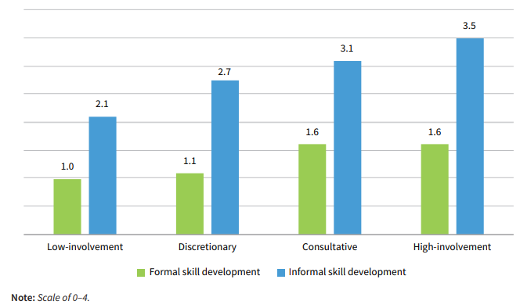
Employee scores on formal and informal skill development indices by organisation type (EWCS, 2015)

Slide 17
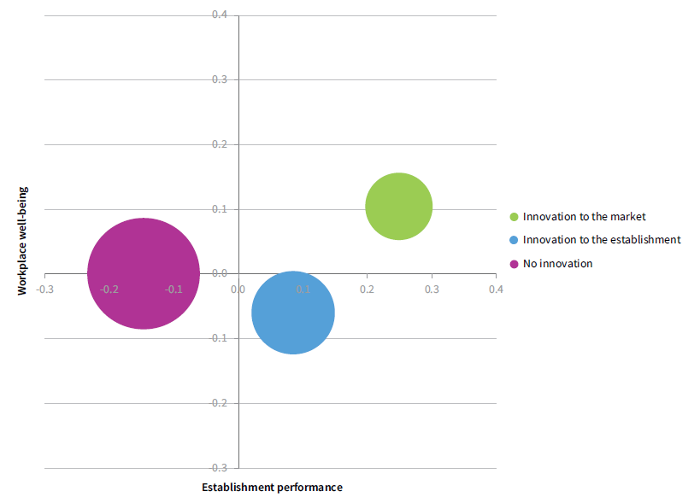
What are the outcomes of innovation?
Customer satisfaction
Improved economic performance
Reputation as a good employer and attracting talent (good place to work)

Slide 18
Social dialogue and digitalisation

Slide 19
Training is the top priority topic addressed in collective agreements on digitalisation
Training, skills and development in collective agreements (examples)
Orange(FR): individual coaching to help employees manage new digital tools
ABN-AMRO bank (NL): career advice plans and upskilling of employees to work better in a digital work environment.
Eurogate (D), Pireus Bank (GR): skills assessment, training & social dialogue
Electricity sector (AT), transportation & logistics (DK)
• Training, skills and development
• Work organisation models, ‘humane’ work design
• Working conditions, employment, and industrial relations
• Alleviating risks of job losses
• Telework
Platform work

Slide 20
Company agreement on digitalisation (example)
Gasag, energy provider (Germany)
Internal online crowdsourcing open to all and transparent.
Change in work organisation, gamification as an employee motivator
Standards in working conditions, H&S, learning
Data protection, employee monitoring not allowed
Risk assessment

Slide 21
Sectoral collective agreements on digitalisation(examples)
Country | Agreement
Denmark | Local Government Denmark Agreement (2021)
 | Medical staff (2018)
 | Transport (2020-2023)
Finland | Technology sector (2020)
Germany | Public sector ongoing (2021)
Italy | Electricity (2019)
 | Gas & water (2019)
 | Banking (2015-2019)
Netherlands | Insurance (2019-2021)
Romania | Banking
Spain | Medical transport Public admin and property registry (2020)
Monitoring transformation of jobs, skills,
work tasks, job classifications, setting up
observatories, cooperating with training providers

Slide 22
Conclusions
Rethinking of management practices for innovation (and digital transformation)
Design jobs that are challenging and give autonomy to employees
Have high expectations of employees but motivate them too; invest in skills and line managers’ skills!
Reward performance
Involve staff in decision making
Collaborate with other companies and organisations
Digital transformation invites for joint solutions by social partners and exchange of practices and experience

Slide 23
Eurofound sources:
Policy brief: Innovation in EU companies: Do workplace practices matter?
What can companies do to spark innovation in the workplace? Blog
Working paper: European Company Survey 2019: Innovation and workplace practices in European establishments
European Company Survey 2019 - Workplace practices unlocking employee potential
Social partners going digital (forthcoming)
Digitisation in the workplace

Slide 24
Thank you!

