Slide 1
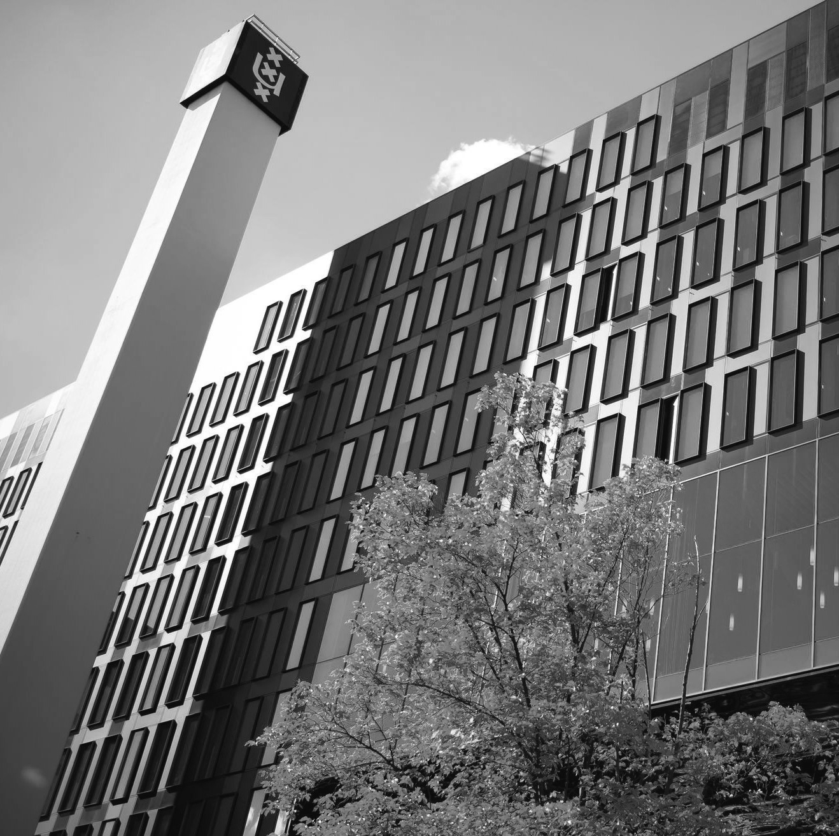
Comparatives in Decentralised bargaining (CODEBAR)
Intro Frank Tros
Conference Adapt-ILO
26 November 2021
Notes:
Achtergrond:
Onduidelijk waar iedereen mee bezig is: langs elkaar heenwerken ipv samenwerken
Oude structuren van bijeenkomsten houdt tweedeling in stand
2. Via inhoudelijke verbinding ook sociaal verbinden
<number>

Slide 2
Common research framework in 8 European countries
Regulative contexts
Institutions in collective bargaining and employee representation
Strategies/resourcesDecentralised bargaining
employers, unions, workers representatives
Practises company bargaining
Quality of negotatiations
Bargaining results
Role workers representatives other than unions?
Cases in Manufacturing & Retail
Notes:
1
2 Strategic choices of bargaining parties to more or less decentralisation relating to power relations, interests, capacities
3 Case studies in manufacturing, retail en
<number>

