Slide 1
The HR Services Industry in the New Normal: creating more value for the world of work
Presentation by: Bettina Schaller, WEC President
ADAPT Conference 2021
Bergamo, Italy
www.wecglobal.org
25th November 2021
@WECglobal

Slide 2
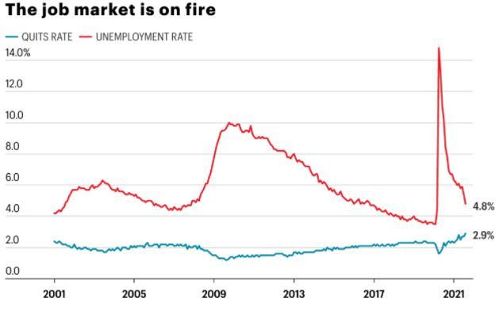
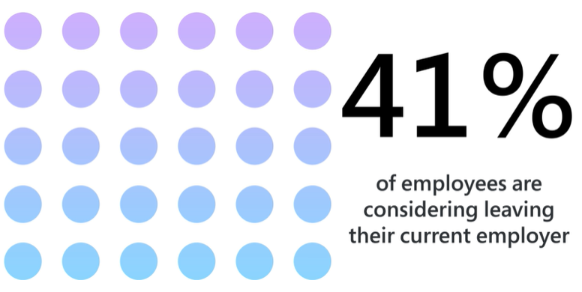
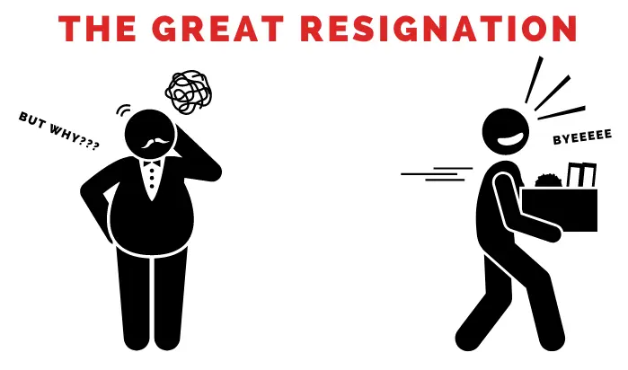
Labour markets in the New Normal
Are we witnessing the “Great Resignation”?
Source: Microsoft – Work Trend Index July 2021
Source: US BLS
Notes:
Is it the Great Resignation? 41% of workers consider leaving their jobs (Survey by Microsoft’s Work Trend Index from 2021)
Unemployment rates are dropping, getting very close to pre-crisis levels
At the same time, quits rates are rising to levels not seen in many years (graph for the US)

Slide 3
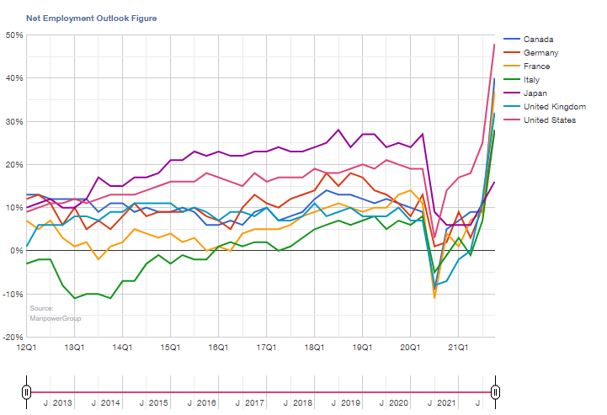
Worker shortages becomes number 1 issue for employers
69% of employers report difficulties in hiring
Source: Manpower Employment Outlook Survey Q4 2021
Notes:
In 15 countries, employers report record-high hiring plans for the current quarter
Simultaneously, 69% of employers across 43 countries report difficulties in hiring, a 15-year high

Slide 4
Labour shortages affect all sectors
No signs of slowing down
Source: Eurostat
Notes:
Looking at different sectors, we see that pretty much all industries are affected by a shortage of workers
Especially those sectors which have been impacted most by containment measures are those that experience the fastest and strongest increase in vacancy rates (accommodation and food services)
In those sectors, demand for workers surged as they were opened up again following the peak-lockdown period and supply cannot keep up
Vacancy rate in this sector is nearly 30% higher in Q2 2021 than in Q2 2019 (pre-crisis)
Other pandemic-related factors also play a role still: fear of catching the disease, restriction in worker migration, built-up savings, job retention schemes (the phasing out of JRS has not (yet) led to the expected rise in new hires
At the same time, we observe that vacancy rates have been increasing for years up until the pandemic
Tight labour markets are back and the current statistics only go until Q2 of this year with no signs of slowing down

Slide 5
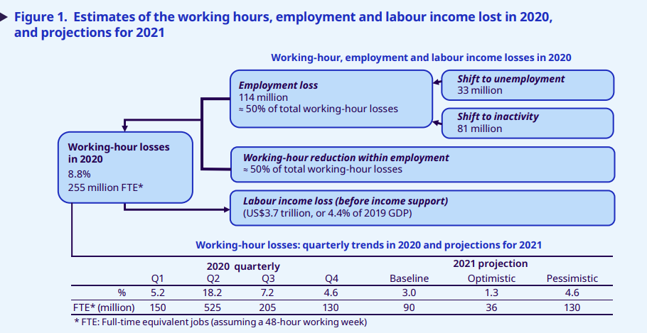
Employment loss mostly shifted to inactivity
Only 30% of lost employment turned to unemployment
Source: ILO Monitor – COVID-19 and the world of work (7th edition)
Notes:
Of course unemployment rates did not capture the full extent of the impact of the pandemic and the containment measures on labour markets
At global level, it is estimated that more than 70% of the employment loss during the crisis is attributed to people becoming inactive
These people lost their work and are not actively searching for new employment
Labour force participation has therefore dropped more significantly than unemployment rates have risen, especially

Slide 6
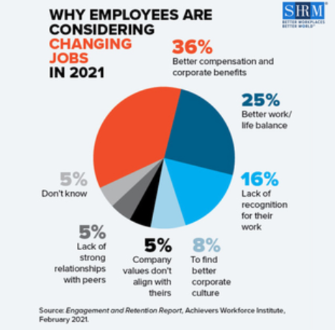
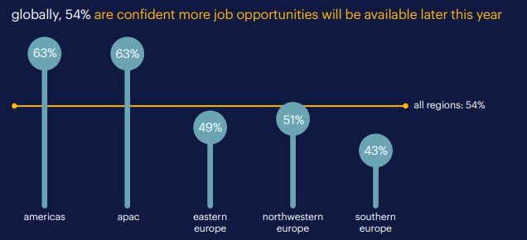
What keeps people away from work?
Expectations have changed
Source: Engagement and Retention Report, Achievers Workforce Institute
Source: Randstad Workforce Monitor 2021
Notes:
While for many workers this is of course not a choice, for others this is a decision
Their evaluation of work has changed
The salary remains a major factor in people’s consideration for leaving their current job
Other factors play a key role as well
Better work/life balance: the pandemic may have re-set their priorities, boundaries have become blurred (at least for those in teleworkable occupations), realisation that life is precious
Most workers globally believe their prospects for finding jobs will improve in the future
Looking at the current labour shortage and the fact that people are able to fall back on built-up savings, they might be holding out with the expectation that better opportunities will arise

Slide 7
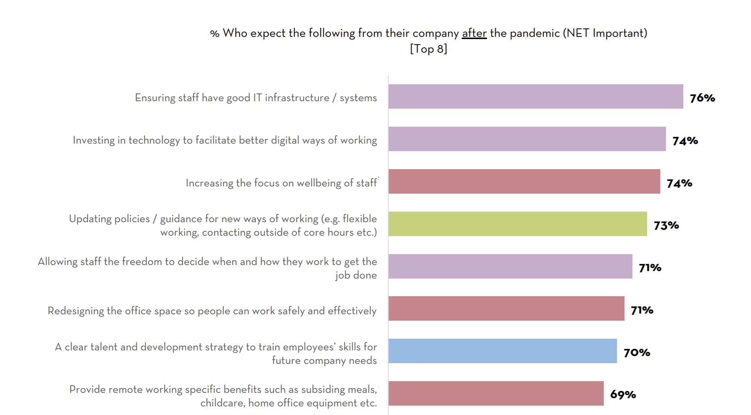
A “Great Re-Evaluation” rather than a “Great Resignation”
Money is no longer the only motivation in work
Source: The Adecco Group – Resetting Normal: Defining the New Era of Work
Notes:
Money is certainly not the only factor in people’s decision to respond to a job offer
Security, employer’s values, purpose, progression opportunities, autonomy and flexibility are growing in importance
3 out of 4 workers globally do not want to lose the flexible ways of working they have become accustomed to over the last 2 years
2 in 5 workers are considering moving to a job with more flexible options
Less than half are satisfied with career prospects at their employer
And it is not just about flexibility. Employees also expect more from their employers regarding well-being, professional development, management, perks, etc.
In a nutshell, they have a lot of expectations for their work to make them happy
So perhaps it is not a Great Resignation, but rather a Great Re-evaluation as people re-evaluate what work means to them

Slide 8
How can the HR Services industry create more value?
8
The HR Services industry…
Supports the transition to new economies
Reskilling to drive sustainable recovery
Delivering diverse working models and career management to facilitate transitions
Delivering adaptation to change
Drives social purpose and social innovation
Boosting opportunities for under-represented groups
Reviewing social protection mechanisms through innovative mechanisms
Reducing informal work
Simplifies increasing labour market complexity
Making sense of new technology for recruitment and workforce management
Implementing new ways of working (e.g. hybrid work)
Providing agile workforce solutions
Acts as a solution provider in terms of risk management
Managing workforce-related risks (compliance, productivity, skills obsolescence, etc.)
Mitigating the unemployment risk (job creation, transitions, career management)
Managing a broader range of risks (health and safety, well-being, etc.)
Delivers responsible intermediations and makes jobs markets work
Ensuring a high degree of compliance with labour laws and protecting the interests of workers and end users
Delivering new forms of work under an organised and regulated framework
Committing to constructive industrial relations resulting in positive outcomes for all parties
Notes:
Employers need to take workers’ re-evaluation of values into account and meet their expectations in order to ensure healthy labour force participation
The HR Services Industry can be part of the set of solutions here
At its core, it has the mission to improve the value of labour markets for society, workers and businesses
For society, the industry helps reduce unemployment, improves matching processes and speed, developing innovative social solutions
For businesses, the industry offers access to needed talent and helps them to manage risks
For workers, the industry facilitates access to safe, decent and quality jobs, delivers career guidance and skilling, supports inclusive labour markets and offers a wide range of work arrangements that cater to diverse work-life balance expectations
The mission of the industry can be described by these 5 messages
We support the transition to new economies, drive social purpose and social innovation, simplify labour market complexity, provide risk management solutions and deliver responsible intermediation
Let us demonstrate how the industry delivers on these by concrete examples

Slide 9
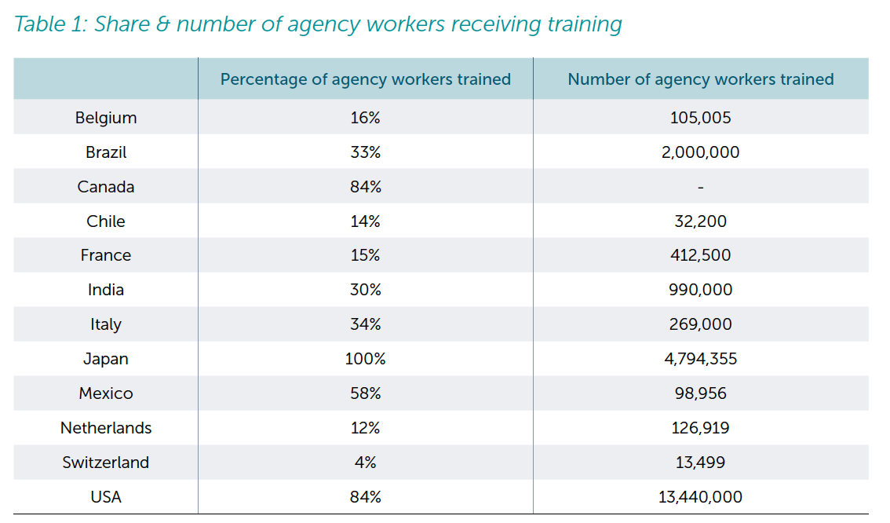
Supporting transitions to new economies
Creating value through up/re-skilling
Source: 2021 WEC Social Impact Report
Notes:
OECD estimates that half of all adults are not engaged in adult learning
The pandemic and digitalisation amplifies this challenge, as there will be increasing needs for workers to move to new occupations or sectors
Each year, millions of workers around the world take advantage of training schemes offered by the HR Services Industry
Career management and career guidance services, part of the HR Services industry, are also becoming increasingly critical in facing the need for worker transitions
Globally, job-to-job transitions are on average 30%-50% quicker when a career management firm is involved

Slide 10
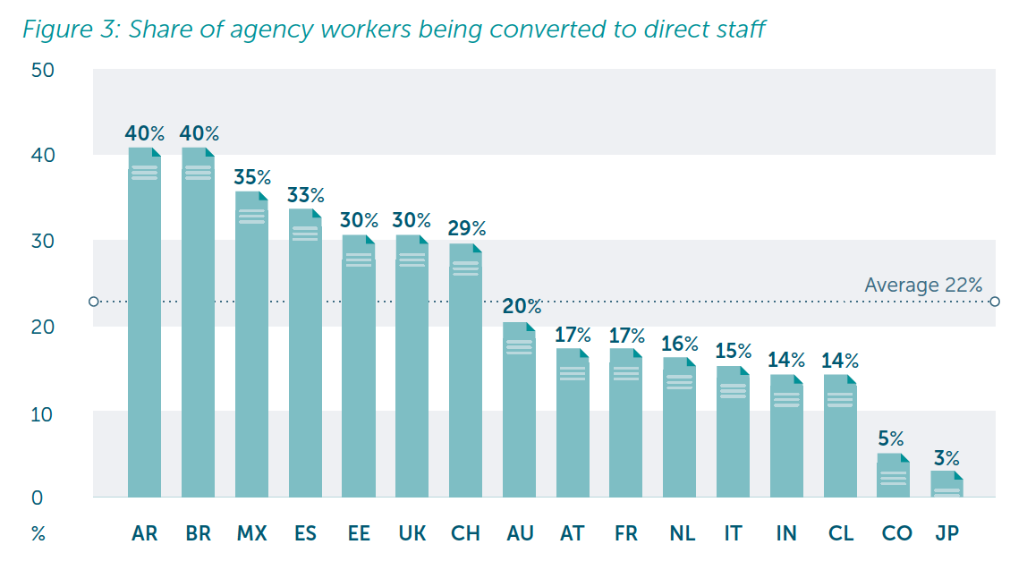
Enabling career transitions
Creating value by securing long-term employability
Source: 2021 WEC Social Impact Report
Notes:
The industry plays a critical role in keeping people attached to the labour market
72% of agency workers remain in employment after having started out with a job in the industry
They may move on to other employment arrangements or are converted to direct employees at the company they had been placed by the HR services company
More than one-fifth of agency workers are taken over by the client company

Slide 11
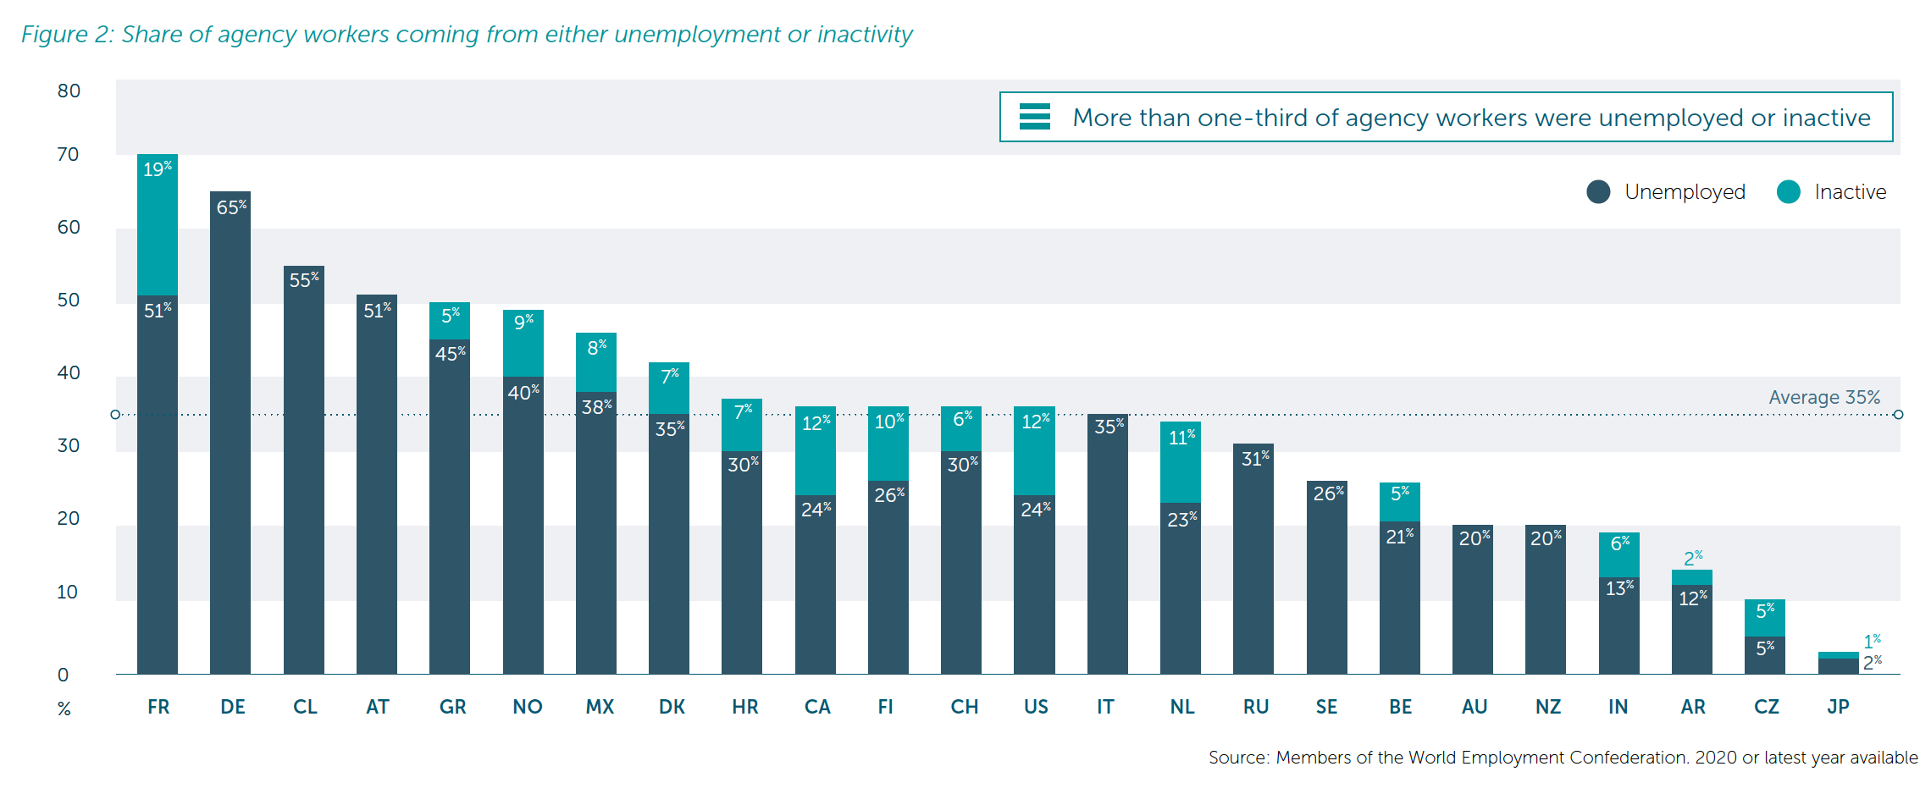
Driving social purpose
Creating value by enabling access to employment
Source: 2021 WEC Social Impact Report
Notes:
The industry also plays a key role in bringing unemployed/inactive into the labour market
35% of agency workers were in non-employment before taking jobs provided by the HR services industry
Highlights the key role in raising labour force participation

Slide 12
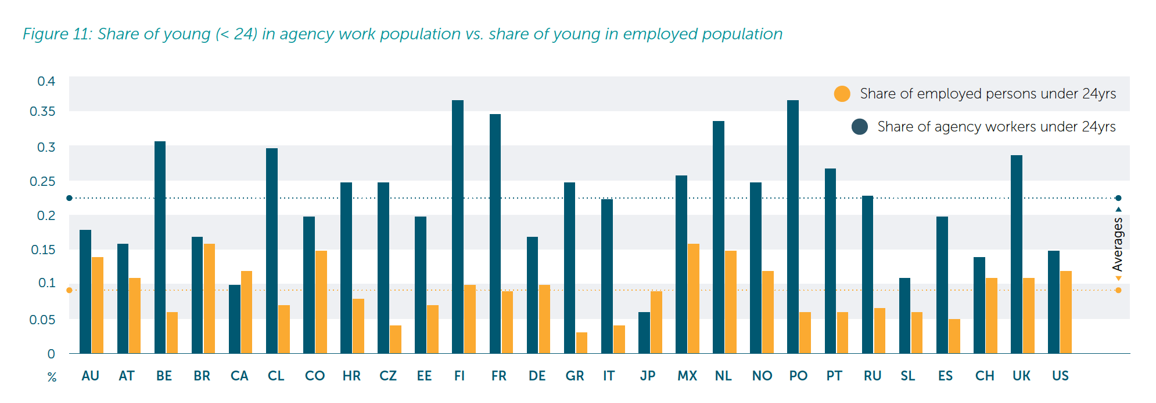
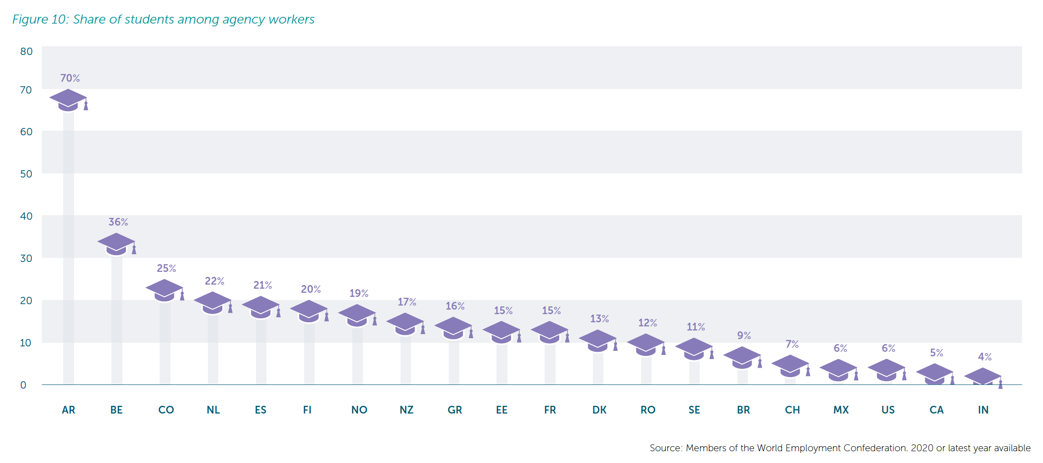
Boosting opportunities for under-represented groups
Creating value for young people
Bla
Source: 2021 WEC Social Impact Report
Notes:
Young people are suffering disproportionally from the pandemic
The number of NEET increased by 3 million across the OECD as a result of the pandemic
In many countries, the share of young people in jobs provided by the HR services industry is higher than the share of young in the overall employed population
This highlights the crucial role of the industry for young people and students, who may be looking for their first entry point to the labour market

Slide 13
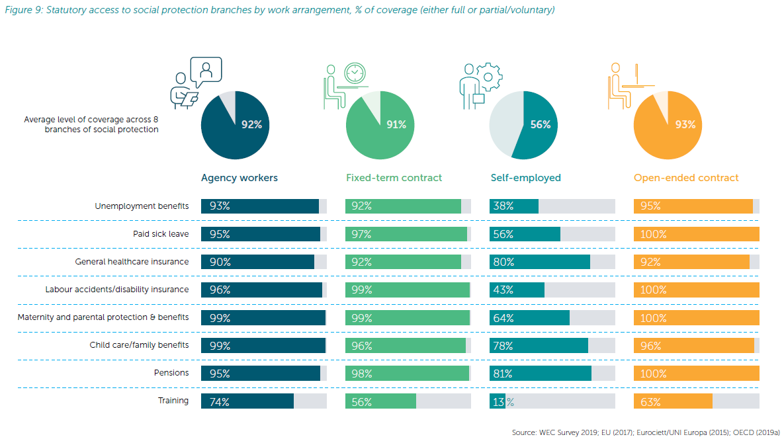
Driving social innovation
Creating value by guaranteeing rights for workers
Source: 2021 WEC Social Impact Report
Notes:
Social protection access has been highlighted as a major challenge during the pandemic
As we know, self-employed workers have been impacted the strongest, often having no effective access to benefits
Regarding statutory access to social protection benefits, it is clear that employed workers enjoy significantly higher levels of access to unemployment benefits, sick leave, health insurance, etc. than self-employed workers
However, in terms of effective access to social protection benefits, there is a significant gap between employees on open-ended, full-time contracts and all other types of workers
This is a challenge that requires a re-evaluation of the social contract to ensure basic levels of protection for all
WEC advocates for basic safety nets for all workers, irrespective of their employment status
Social innovation is key here and the HR Services Industry has developed various schemes that can serve as a good practice here

Slide 14
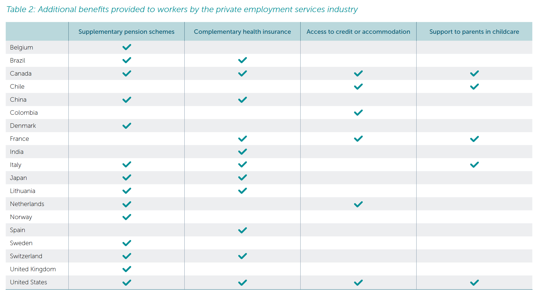
Driving social innovation
Creating value by establishing innovative safety nets
Source: 2021 WEC Social Impact Report
Notes:
Agency workers often benefit from sectoral supplementary provisions in order to top-up their effective access to benefits
Social partners engage in collective bargaining and develop sectoral funds and solutions that benefit the workers
These can be portable rights to improve access to safety nets, training funds or schemes to improve workers’ health insurance access
The OECD recognised that the outcomes of these collective bargaining exercises often result in more generous provisions being available to agency workers than to regular employees on fixed-term contracts

Slide 15
Making the jobs market work
Creating value by contributing to economic growth
Source: WEC National Federation members. Eurostat
Notes:
The HR services industry plays a key role in labour markets and economies
Raising labour market participation and lowering unemployment, it contributes to economic growth and inclusive labour markets
Activity in the sector has always been highly cyclical, due to the nature of the industry
It is also an early indicator of where the economy is heading
This can be seen even during the current crisis
In Q1 2021, GDP growth in the EU remained negative year-on-year, although close to beginning the recovery
Agency work activity had already picked up then, growing positively in the same quarter, signalling the turn-around point

Slide 16
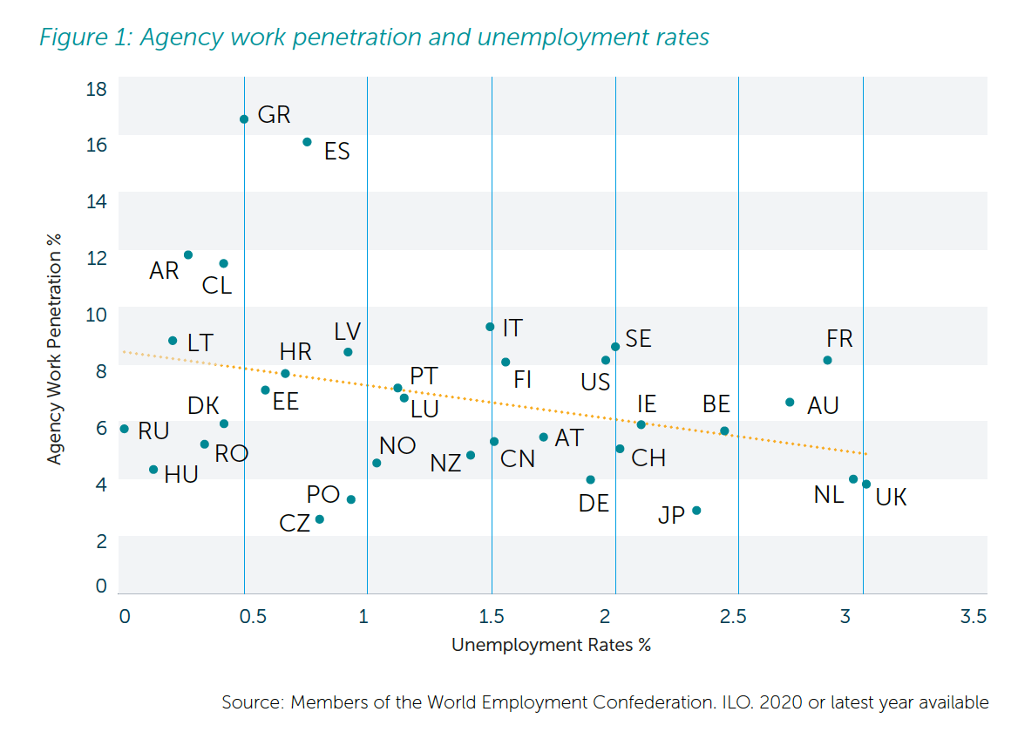
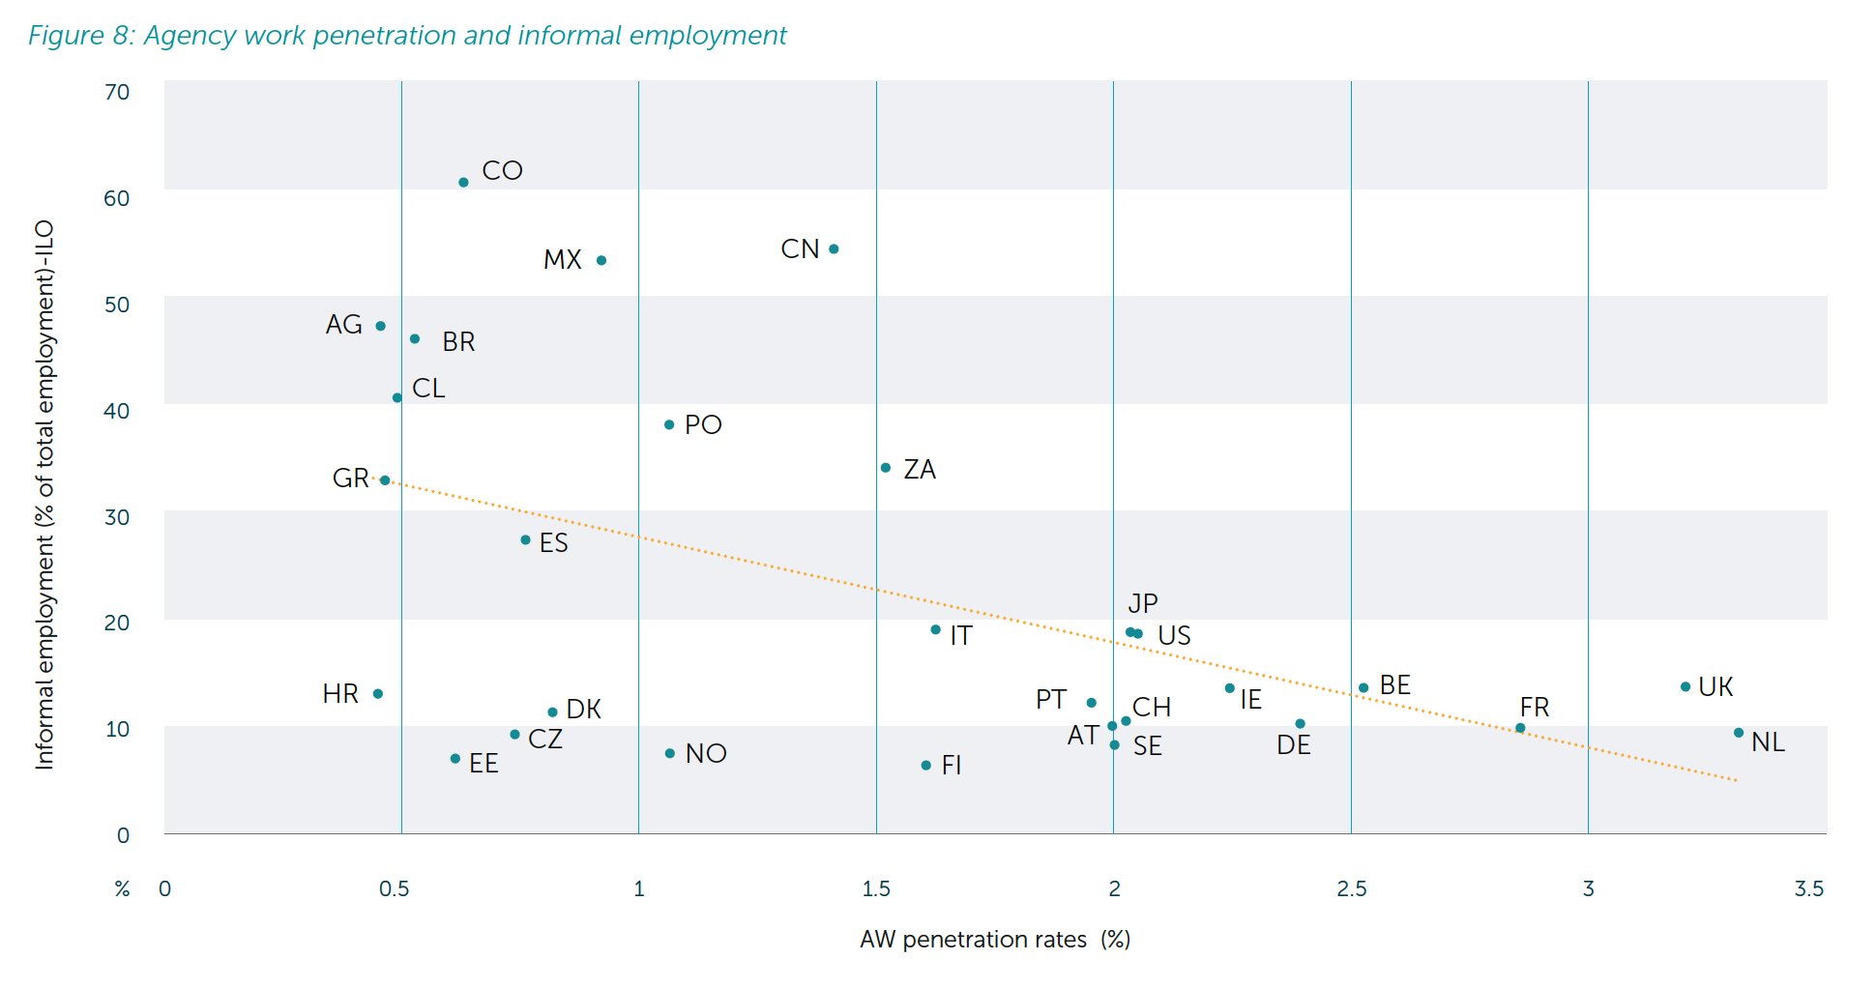
Delivering responsible intermediation
Creating value through formal, decent work opportunities
Source: 2021 WEC Social Impact Report
Notes:
When comparing across countries, we can also see a clear negative correlation between the share of agency workers among the working population and unemployment
This indicates that countries with a higher share of workers employed by the HR Services Industry have lower unemployment rates
At the same time, the industry raises formal employment, providing legally recognised labour contracts
We observe a significant negative correlation between the share of agency workers and the level of informal employment across countries

Slide 17
Thank you
-
Bettina Schaller
WEC President
@WECglobal
www.wecglobal.org
Notes:
Labour markets were already undergoing deep transformations and the Covid-19 crisis has only served to accelerate this change. As we have seen, expectations are changing and as the theme of this conference rightly points to, the value of work is changing. As private employment services, we know that we can play a role in helping people and organisations redefine the value of work and adapt to new realities. But we need to have a clear view on the situation and the trends and that’s where research plays a key role. We are glad to be long-standing partners with such a valuable network of researchers like ADAPT and to work together to advance the knowledge about the world of work.

