Slide 1
25 November 2021 | WORK AND ITS VALUE | ADAPT-ILO
Recognising and Measuring the Economic and Social Value of Work in a Changing Society: the Centrality of Industrial Relations
Ilaria Armaroli
ADAPT Research Fellow
ilaria.armaroli@adapt.it
@ilaria_armaroli

Slide 2
‘The field [of employment relations] involves the study of employment, with a focus on how labor and management combine to create value and negotiate over its division, as well as how people experience the workplace’
(Doellgast, Bidwell & Colvin (2021). New directions in employment relations theory: Understanding fragmentation, identity, and legitimacy. ILR Review, 74(3): p. 556)

Slide 3
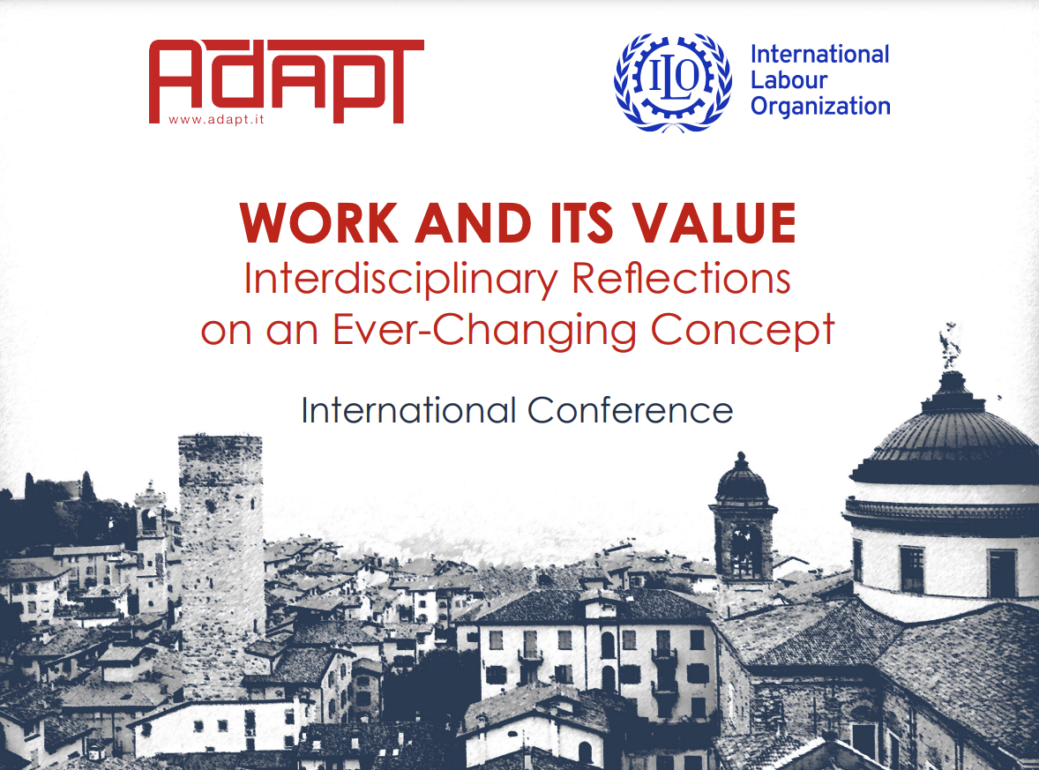

Slide 4
‘Human fulfillment is impossible outside of and apart from communal life’
‘… acceptance for a new conception of worker participation in unions as fulfillment through collective, self-governed experience’
(Klare (1982). The public/private distinction in labour law. University of Pennsylvania Law Review, 130: pp. 1419; 1421)

Slide 5
Recalling John W. Budd’s famous conceptualisations of work, industrial relations have served for a long time to release work from being just a curse, a necessary burden for human survival and maintenance, and a commodity, an abstract quantity of productive effort which can be bought and sold in the market.
(Budd (2011). The Thoughts of Work. Cornell University Press)

Slide 7
‘Corals build islands and continents by reconstructing coasts broken up by the incessant action of the waves; insects transmit plant pollen while retaining much of the plant life; the condor and the hyena purify the environment of unburied corpses; other animals remove debris, others make honey and wax, other silk, and so on. The mission of life is so immense and essential that the Earth is preserved thanks to life embracing the globe with a layer equivalent to the atmosphere.’

Slide 8
‘… Animals produce more than what their needs require; their activity always results in a surplus which is immensely greater than the direct needs of conservation. Therefore, they are all workers of the universe and observers of universal laws. Man, worker par excellence, cannot escape from these [laws]’
Personal translation from Montessori (1936). Il segreto dell’infanzia. Garzanti, pp. 200-201)

Slide 10
‘Labour is only another name for a human activity which goes with life itself, which in its turn is not produced for sale but for entirely different reasons, nor can that activity be detached from the rest of life, be stored or mobilized’
(Polanyi (1957). The Great Tranformation. Rinehart, p. 57)

Slide 11
firstly, to acknowledge and strengthen the historically overlooked environmental value of work.
secondly, to offset the individualization trends in times of remote work, fragmented career path and rising periphery and multicultural workforce by enriching the social, relational and identity dimensions of paid work.
thirdly, to tackle the problems of low-paid work by finding new ways to assess the economic value of work.
fourthly, to acknowledge, respect and preserve reproductive and domestic work which is not market-mediated and yet extremely and increasingly functional, in age of demographic change, to our economy and societies.

Slide 13
Being not only a commodity exchanged for wages but a part of social life, human work ‘cannot be fully subsumed under contract or competition law, since social life is also cooperative, not for sale, and dependent on social norms that provide essential pre-contractual conditions of contract’
(Dukes & Streeck (2020). Labour Constitutions and Occupational Communities: Social Norms and Legal Norms at Work. Journal of Law and Society, 47(4): p. 620)

Slide 15
firstly, by treasuring and further cultivating the empirical method of early 20th-century American institutionalists and therefore, by carefully analysing real-world actors and practices.
secondly, and partly connected with this, by acknowledging, embodying and voicing as many intellectual approaches and sensitivities to daily reality of work as possible.
thirdly, by valuing and honouring what was traditionally considered as both the strength and weakness of industrial relations (Edwards, 2005), which is the lack of a closed paradigm and yet the integration of multiple disciplines.

Slide 16
fourthly, by taking up Huzzard and Björkman’s suggestion (2015) to engage with more interventionist approaches to industrial relations’ research.
fifthly, by adopting and enhancing an international perspective to the study of work in a globalised world.

Slide 17
in the conviction that if industrial relations still serve a purpose in today changing society, this must be the promotion of a balanced, inclusive and sustainable approach to social development, which cannot but embed work, ‘consuming so much of our daylight hours, conferring income and status, and shaping life-chances in so many ways’
(Ackers (2002). Reframing employment relations: The case for neo-pluralism. Industrial Relations Journal, 33(1): p. 15)

Slide 18
@ADAPT_bulletin
@adaptland

